Slide 1
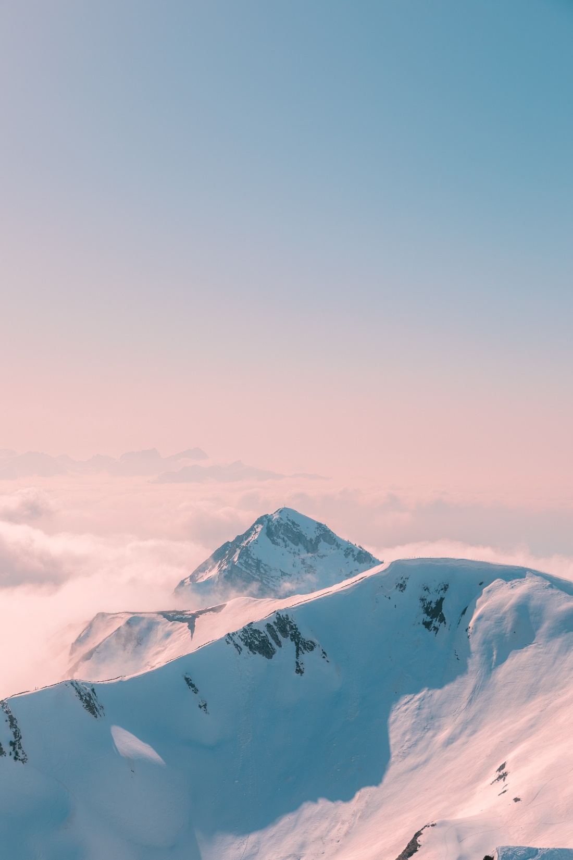
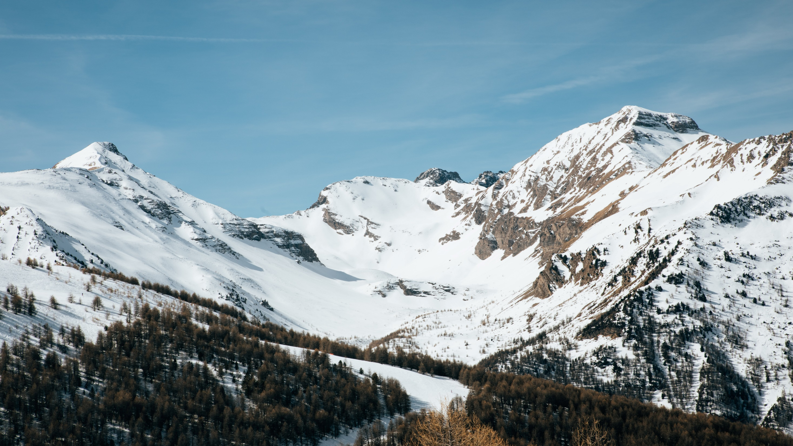
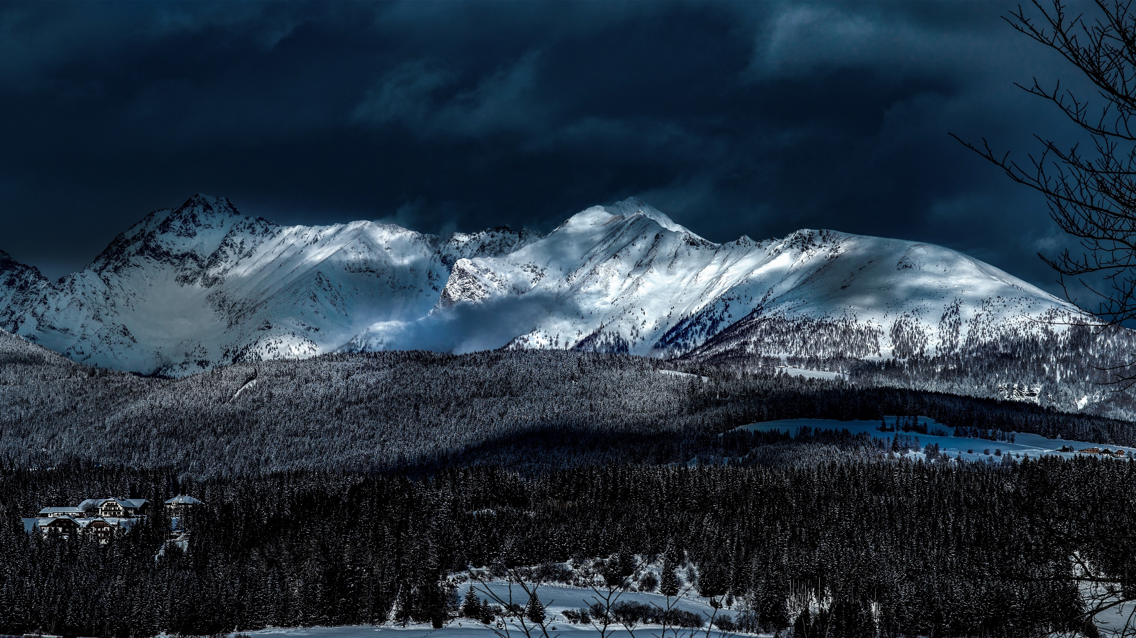
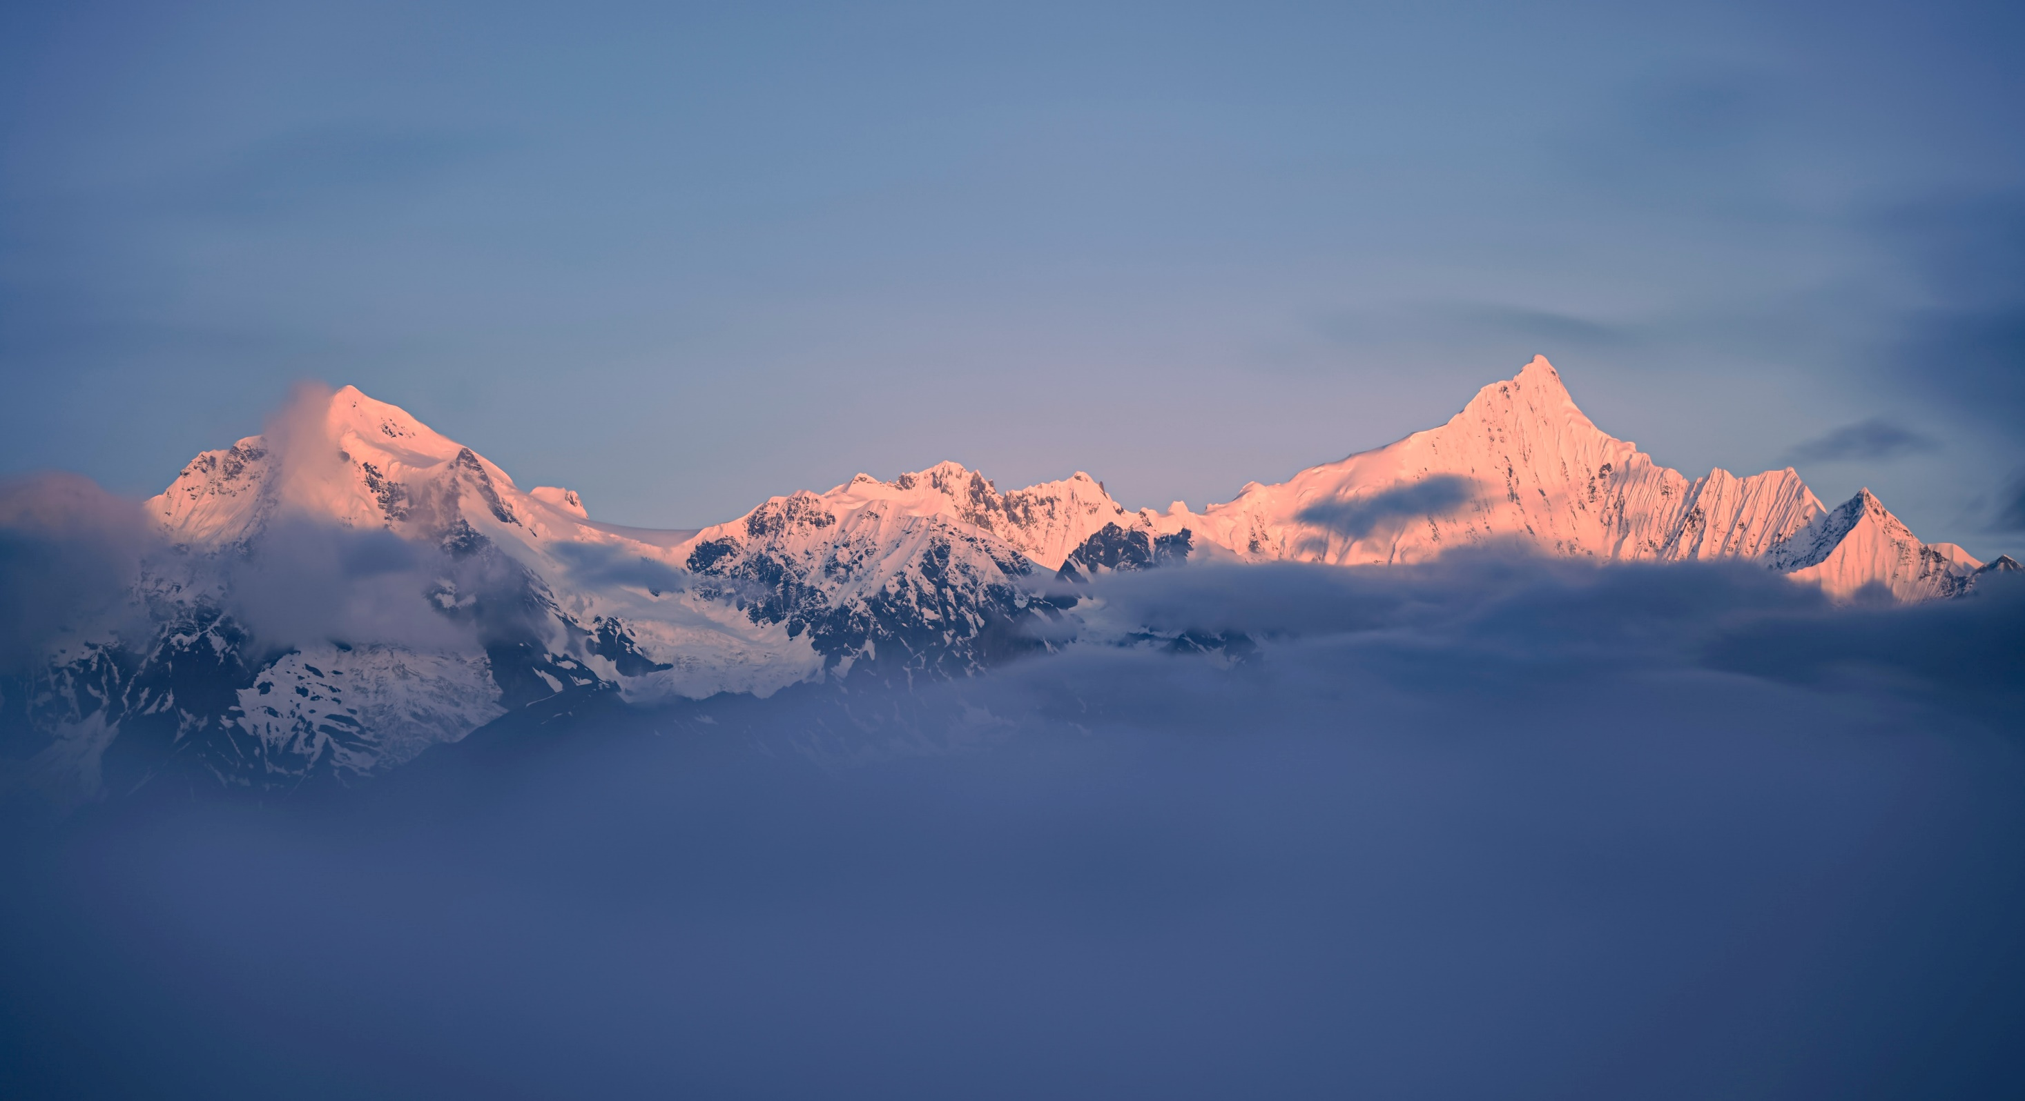
Home
Explore
Advert
community
Arknights
Log in/sigh up
Kjerag Archives
Kjerag,
a religious country
located in
the north central part of
the mainland.
View more
It is not affected by natural disasters all the year round, with steep terrain and closed and conservative

Slide 2
Kjerag Archives
Home
Explore
Advert
community
Arknights
Log in/sigh up
Scenery
build
Kjerag,
Maybe
you
want…
a religious country
located in
the north central part of
the mainland.
exhibit
“them”
It is not affected by natural disasters all the year round, with steep terrain and closed and conservative

Slide 3
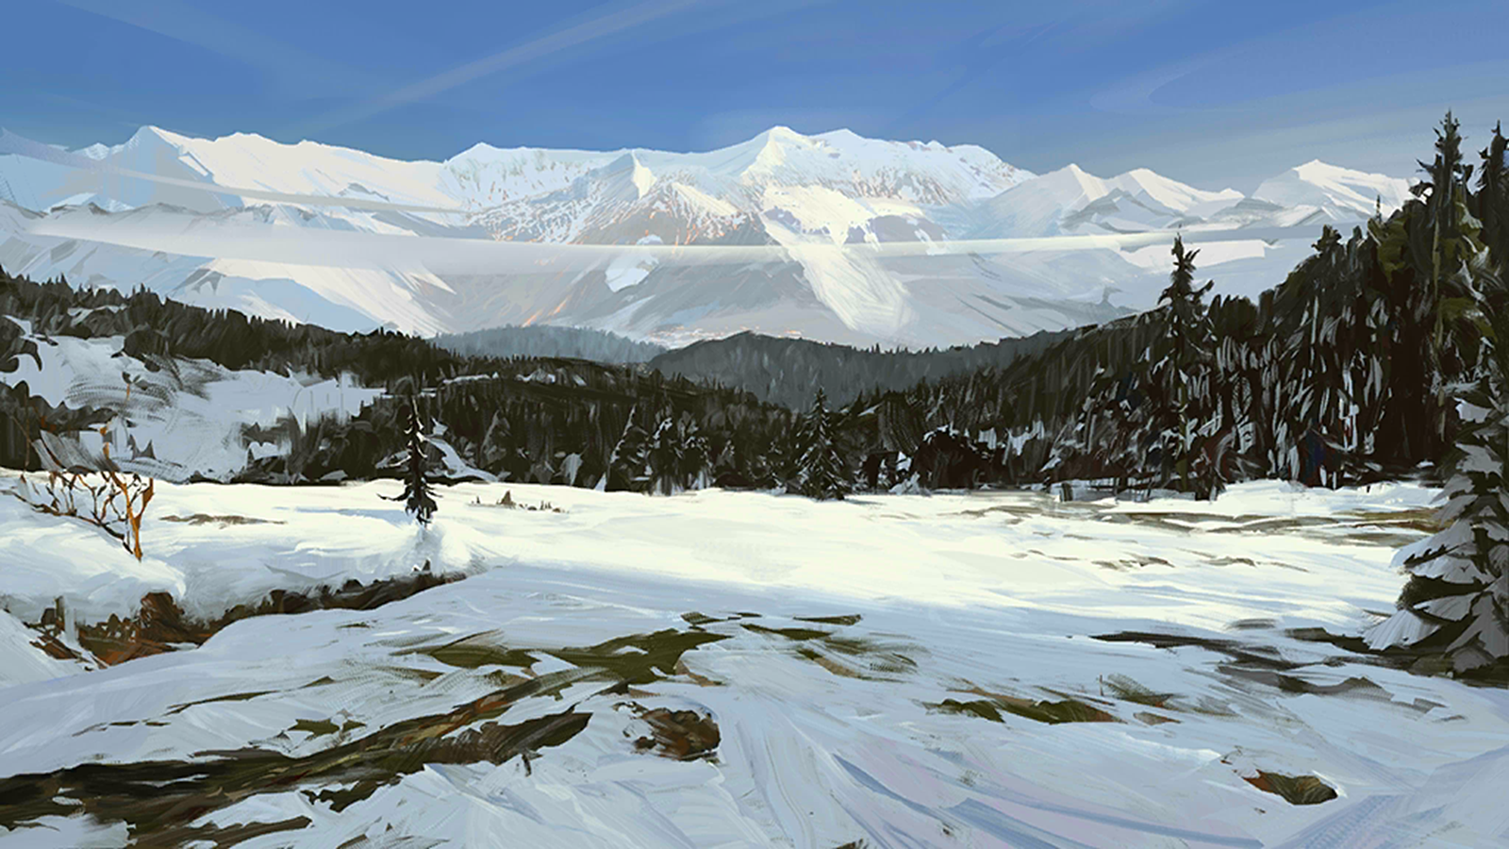
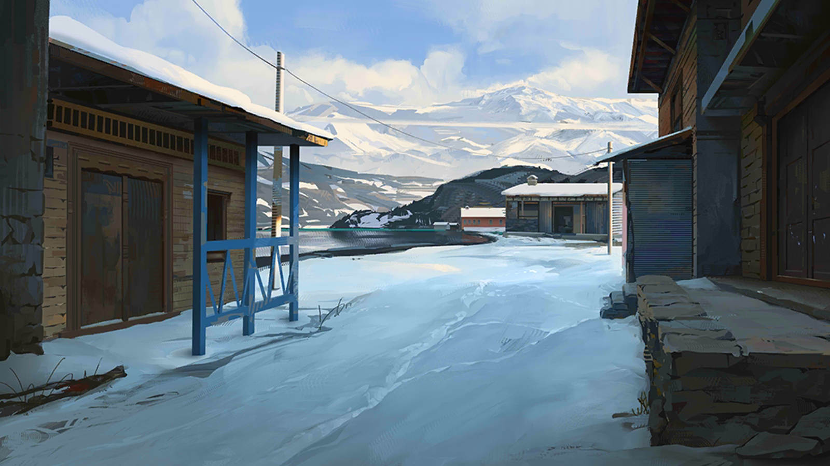
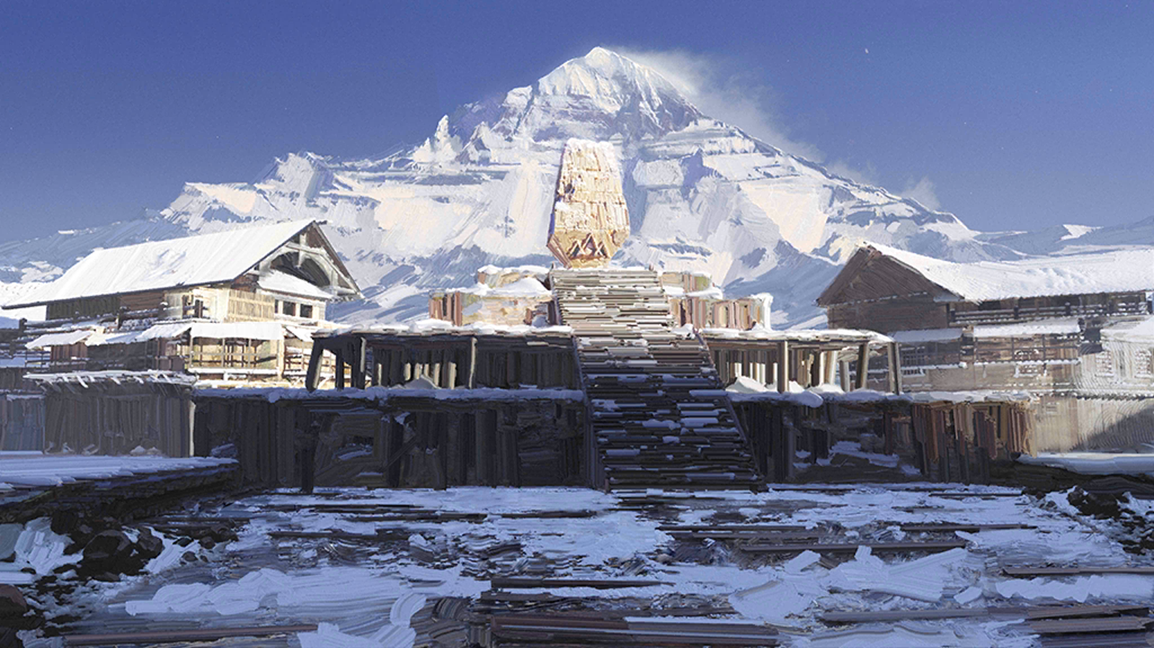
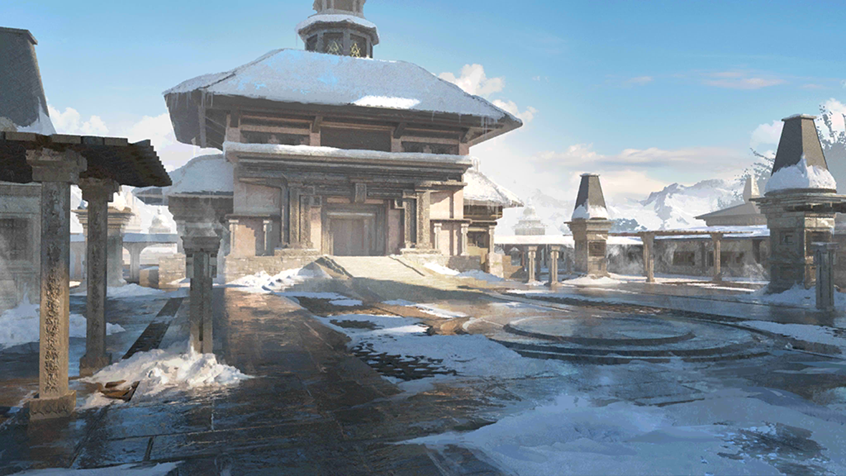
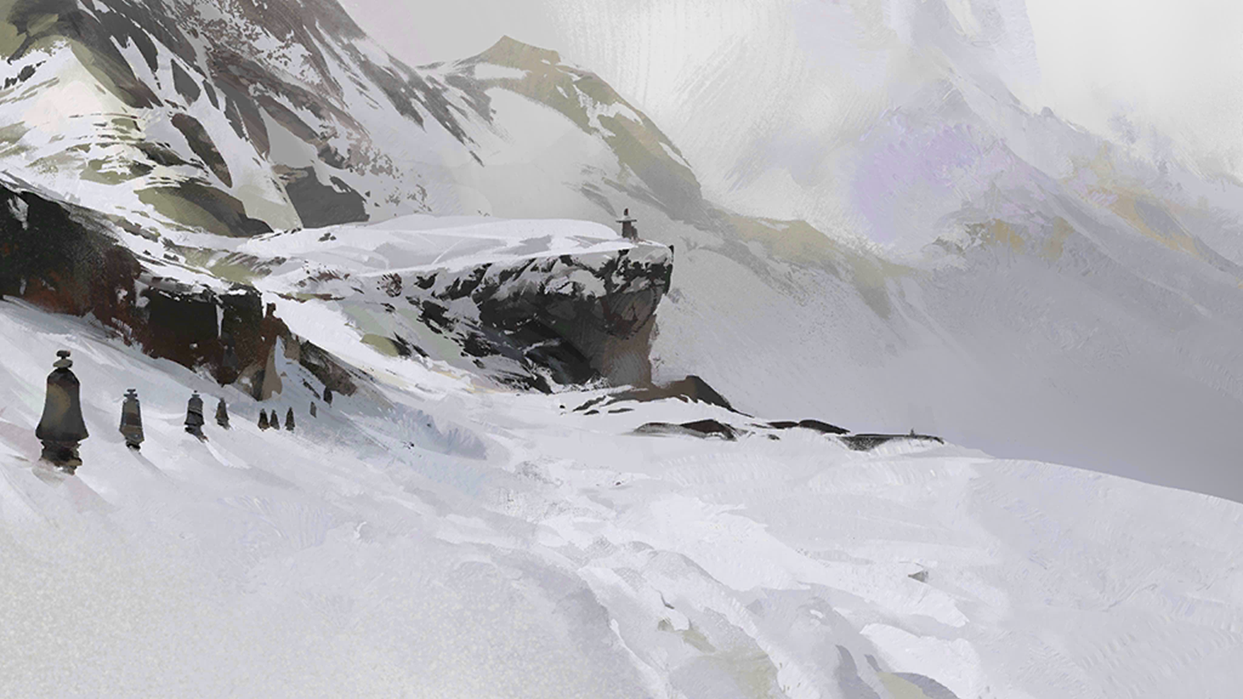
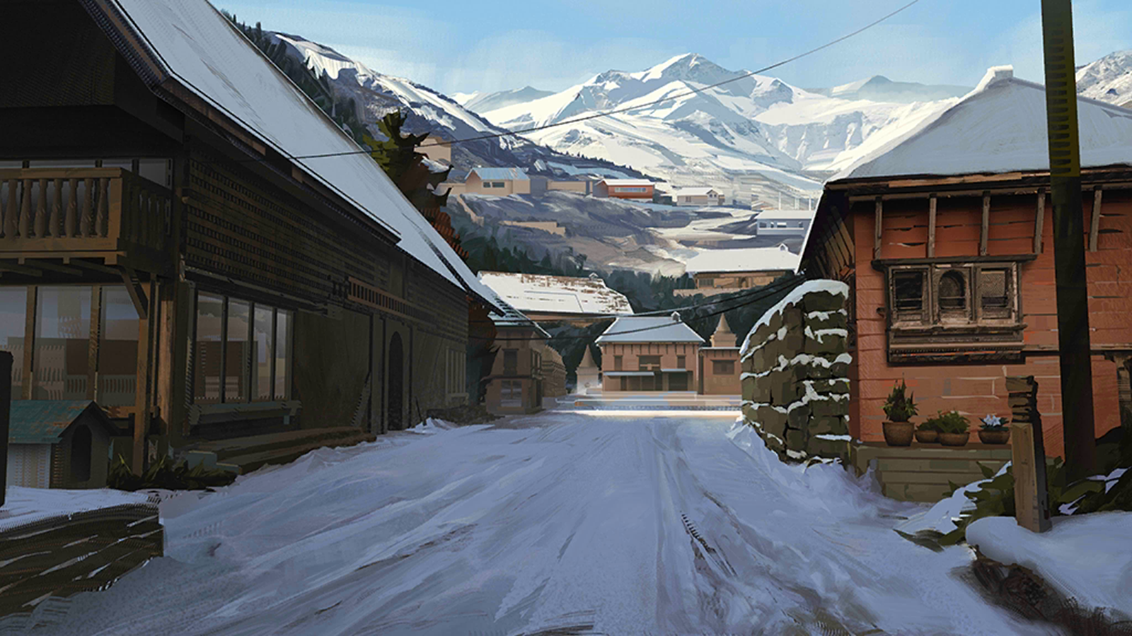
Kjerag Archives
Home
Explore
Advert
community
Arknights
Log in/sigh up
Scenery
Kjerag,
a religious country
located in
the north central part of
the mainland.
It is not affected by natural disasters all the year round, with steep terrain and closed and conservative

Slide 4
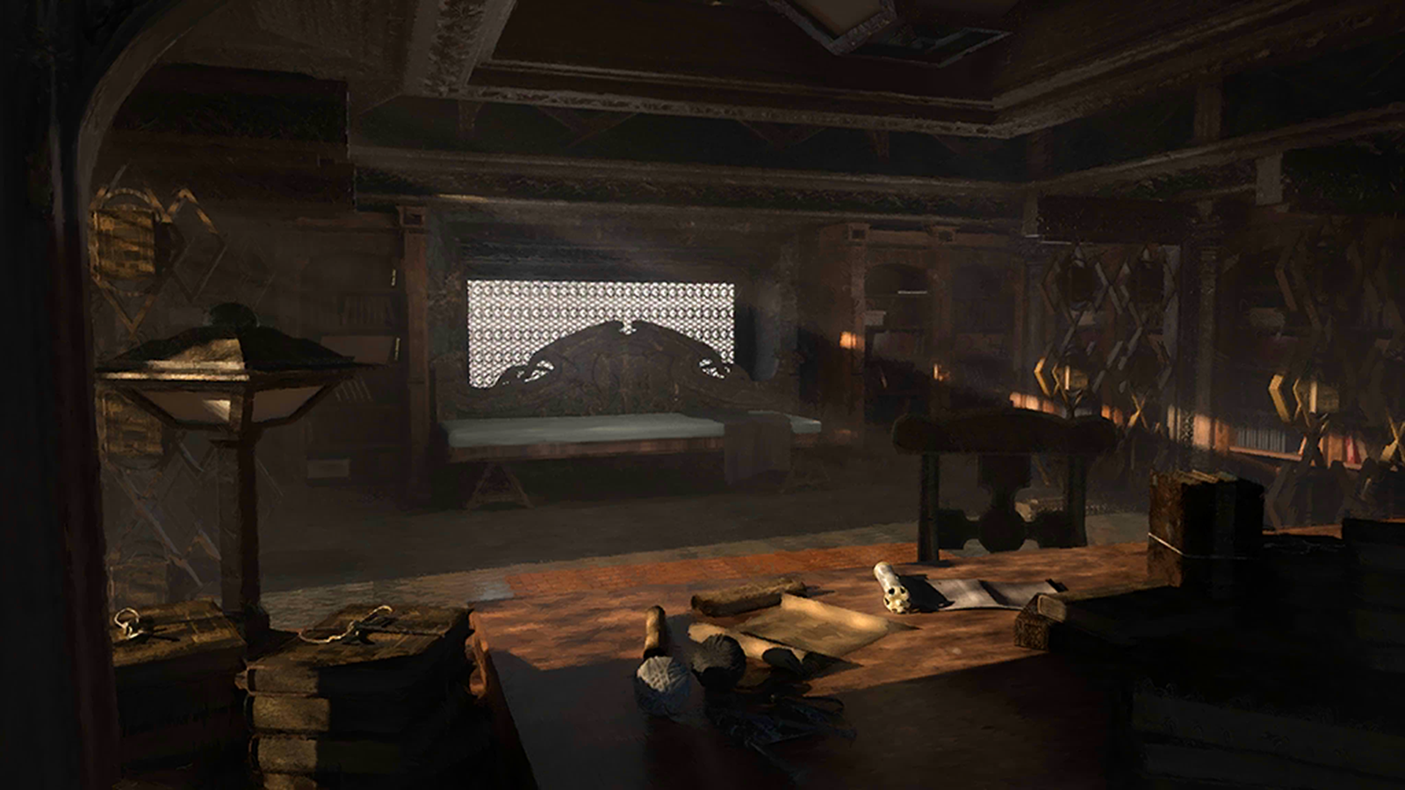
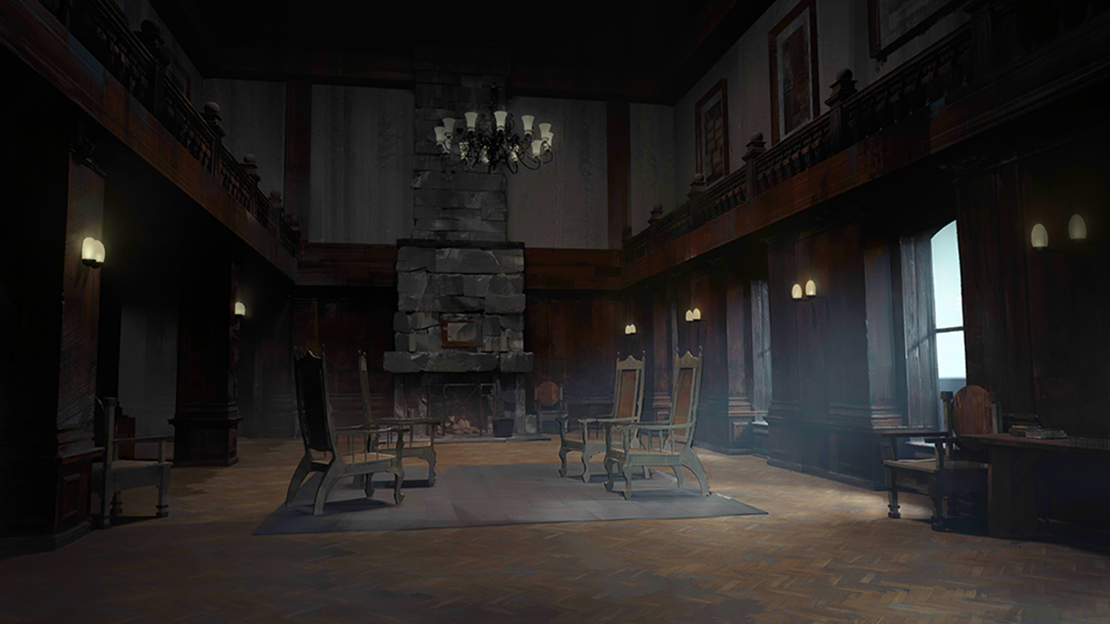
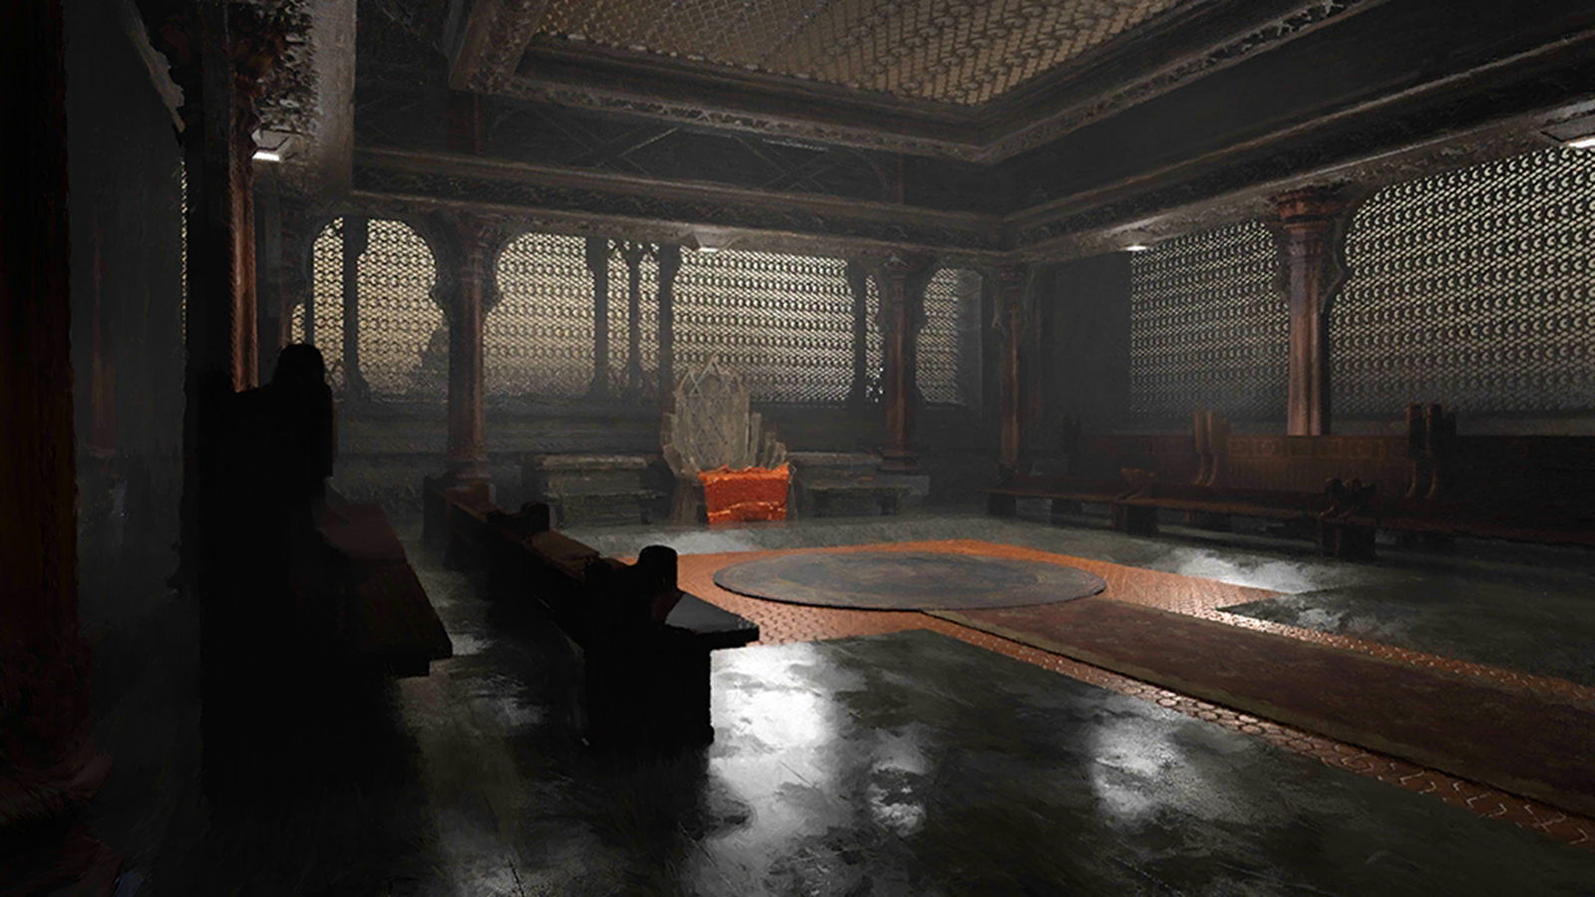
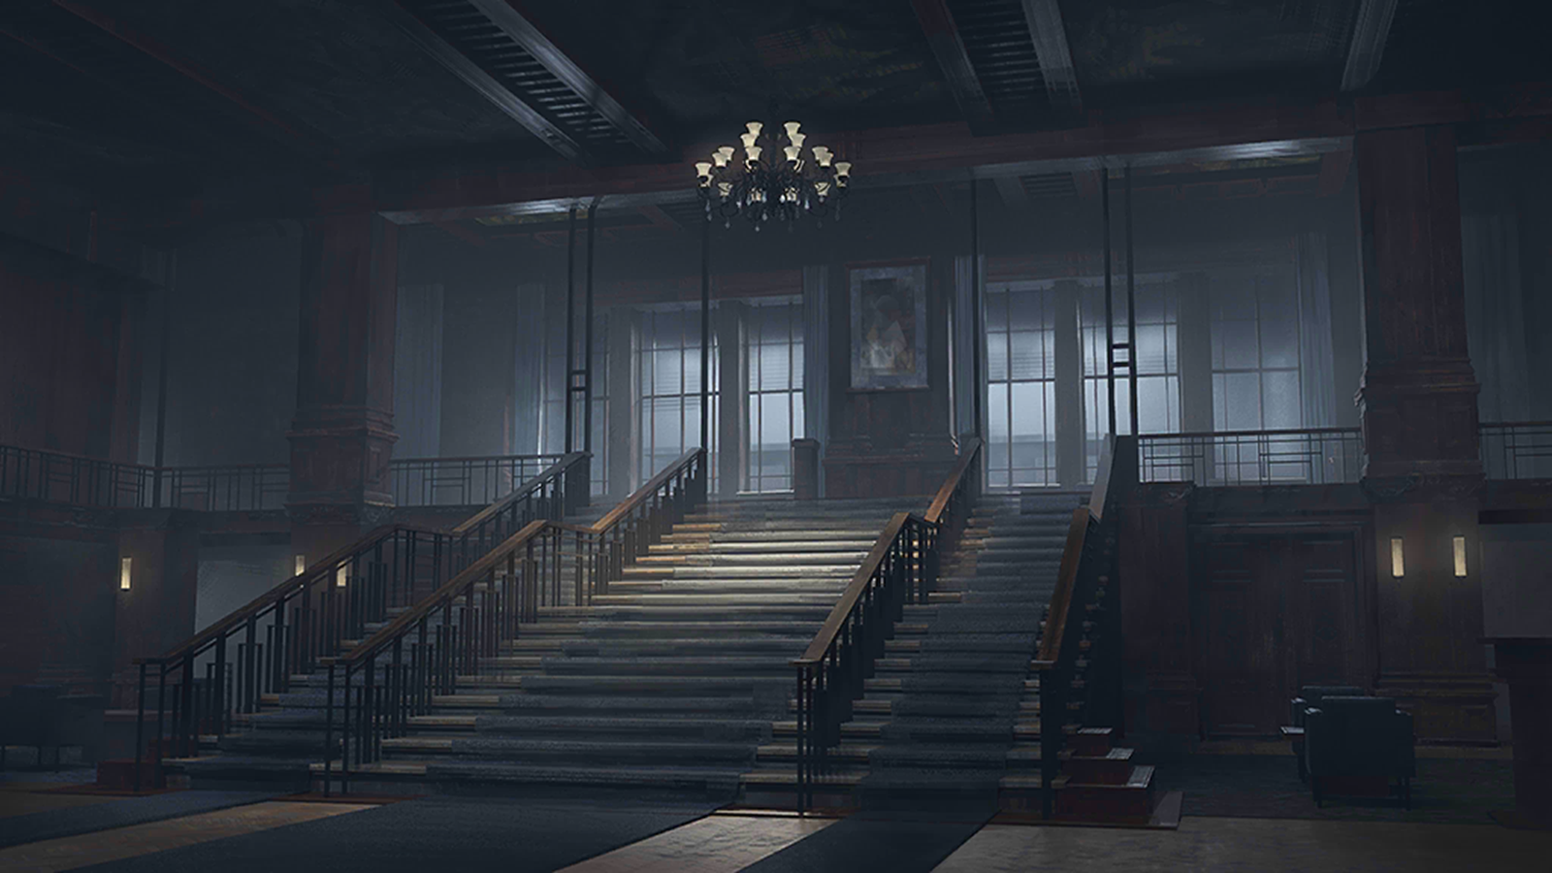
Kjerag Archives
Home
Explore
Advert
community
Arknights
Log in/sigh up
build

Slide 5

Kjerag Archives
Home
Explore
Advert
community
Arknights
Log in/sigh up
back
Scenery
Because it snows
all the year round,
the Sherag people
call their country
a snow land

Slide 6
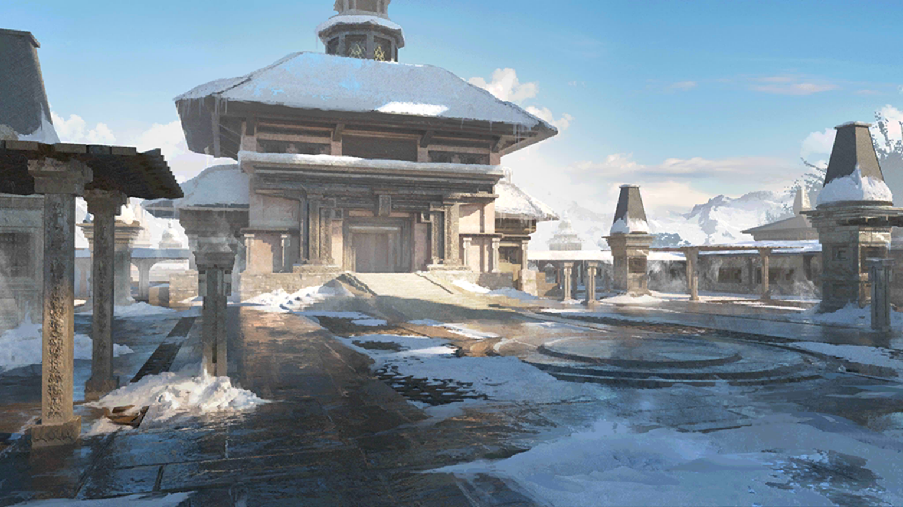
Kjerag Archives
Home
Explore
Advert
community
Arknights
Log in/sigh up
back
Scenery
snow land often more well-known than the name of the country.

Slide 7

Kjerag Archives
Home
Explore
Advert
community
Arknights
Log in/sigh up
back
Scenery
snow land often more well-known than the name of the country.

Slide 8

Kjerag Archives
Home
Explore
Advert
community
Arknights
Log in/sigh up
back
Scenery
snow land often more well-known than the name of the country.

Slide 9

Kjerag Archives
Home
Explore
Advert
community
Arknights
Log in/sigh up
back
Scenery
snow land often more well-known than the name of the country.

Slide 10

Kjerag Archives
Home
Explore
Advert
community
Arknights
Log in/sigh up
back
Scenery
snow land often more well-known than the name of the country.

Slide 11

build
Kjerag Archives
Home
Explore
Advert
community
Arknights
Log in/sigh up
back
Sherag is a religious country with a very high religious status.

Slide 12

build
Kjerag Archives
Home
Explore
Advert
community
Arknights
Log in/sigh up
back
Sherag is a religious country with a very high religious status.

Slide 13
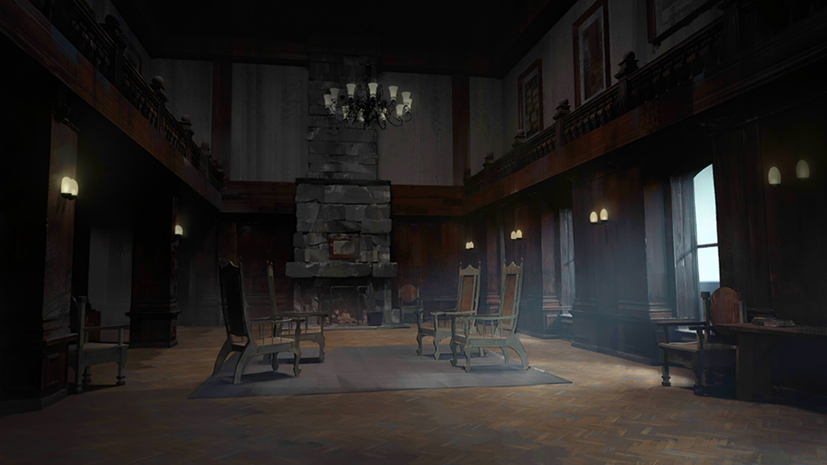
build
Kjerag Archives
Home
Explore
Advert
community
Arknights
Log in/sigh up
back
Sherag is a religious country with a very high religious status.

Slide 14

build
Kjerag Archives
Home
Explore
Advert
community
Arknights
Log in/sigh up
back
Sherag is a religious country with a very high religious status.

Slide 15
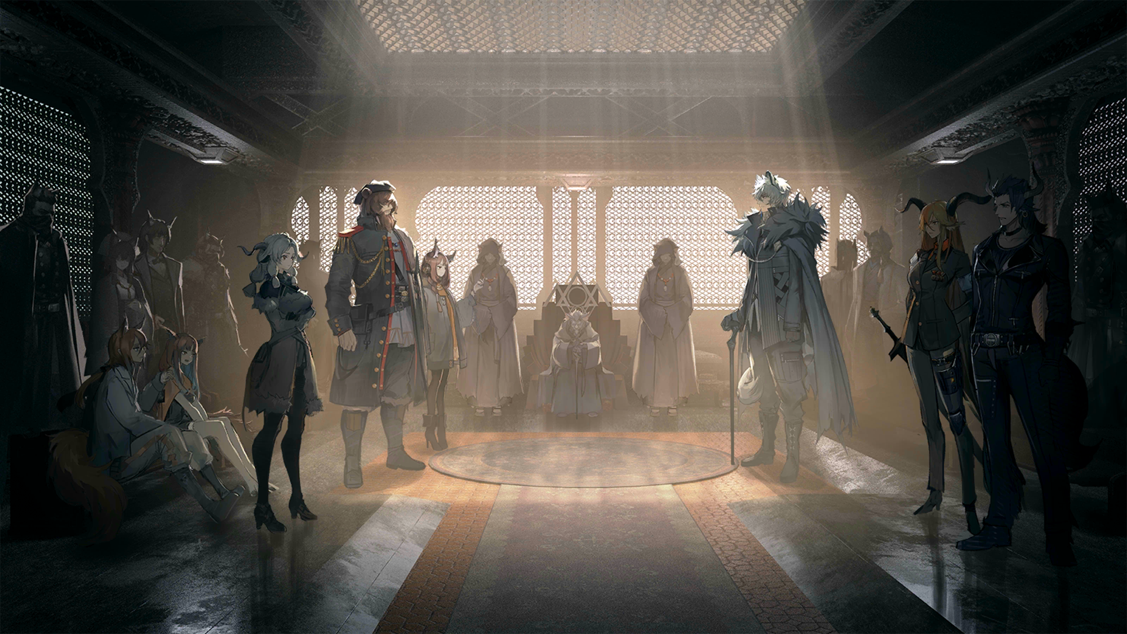
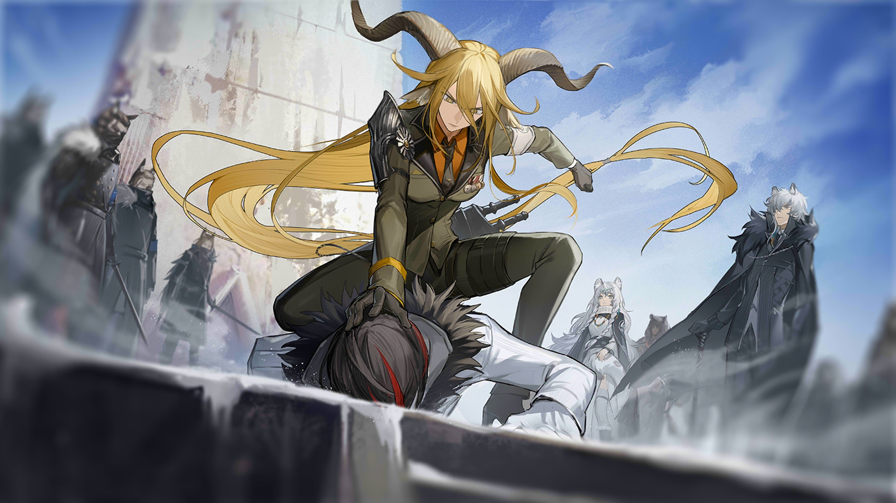
Kjerag Archives
Home
Explore
Advert
community
Arknights
Log in/sigh up
back
“meeting“

Slide 16
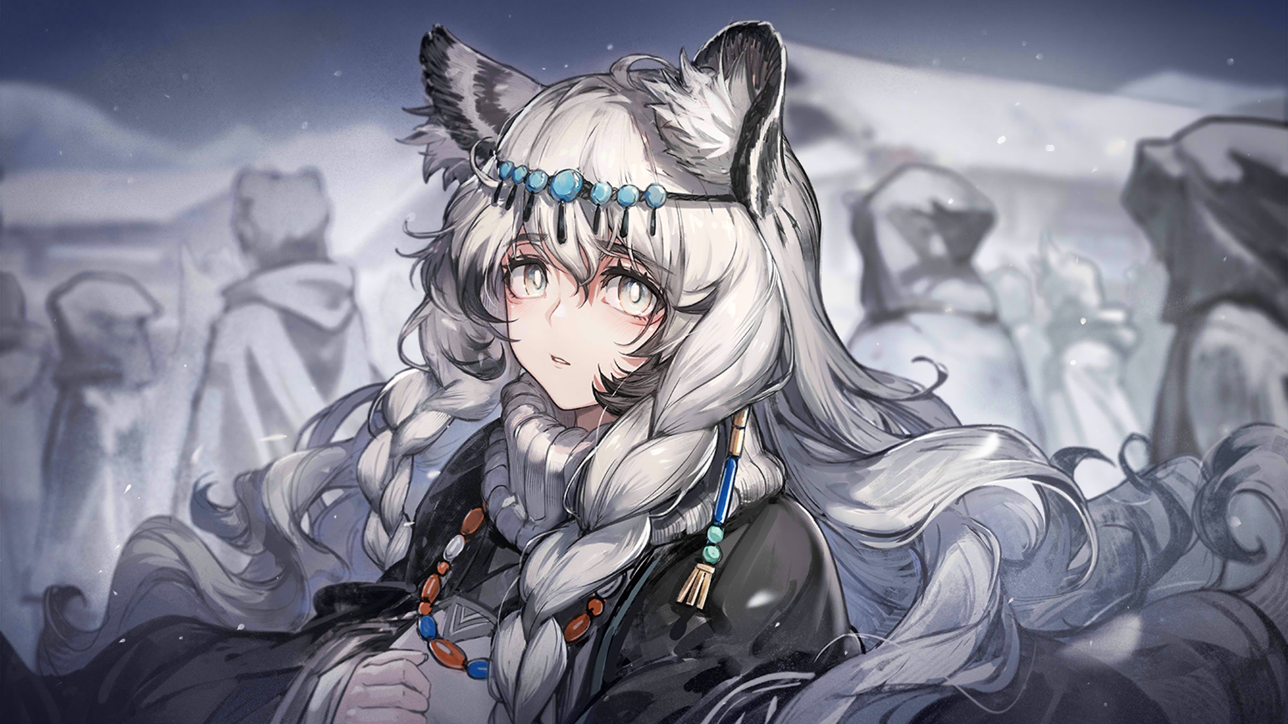
Kjerag Archives
Home
Explore
Advert
community
Arknights
Log in/sigh up
back
“comedy“

Slide 17
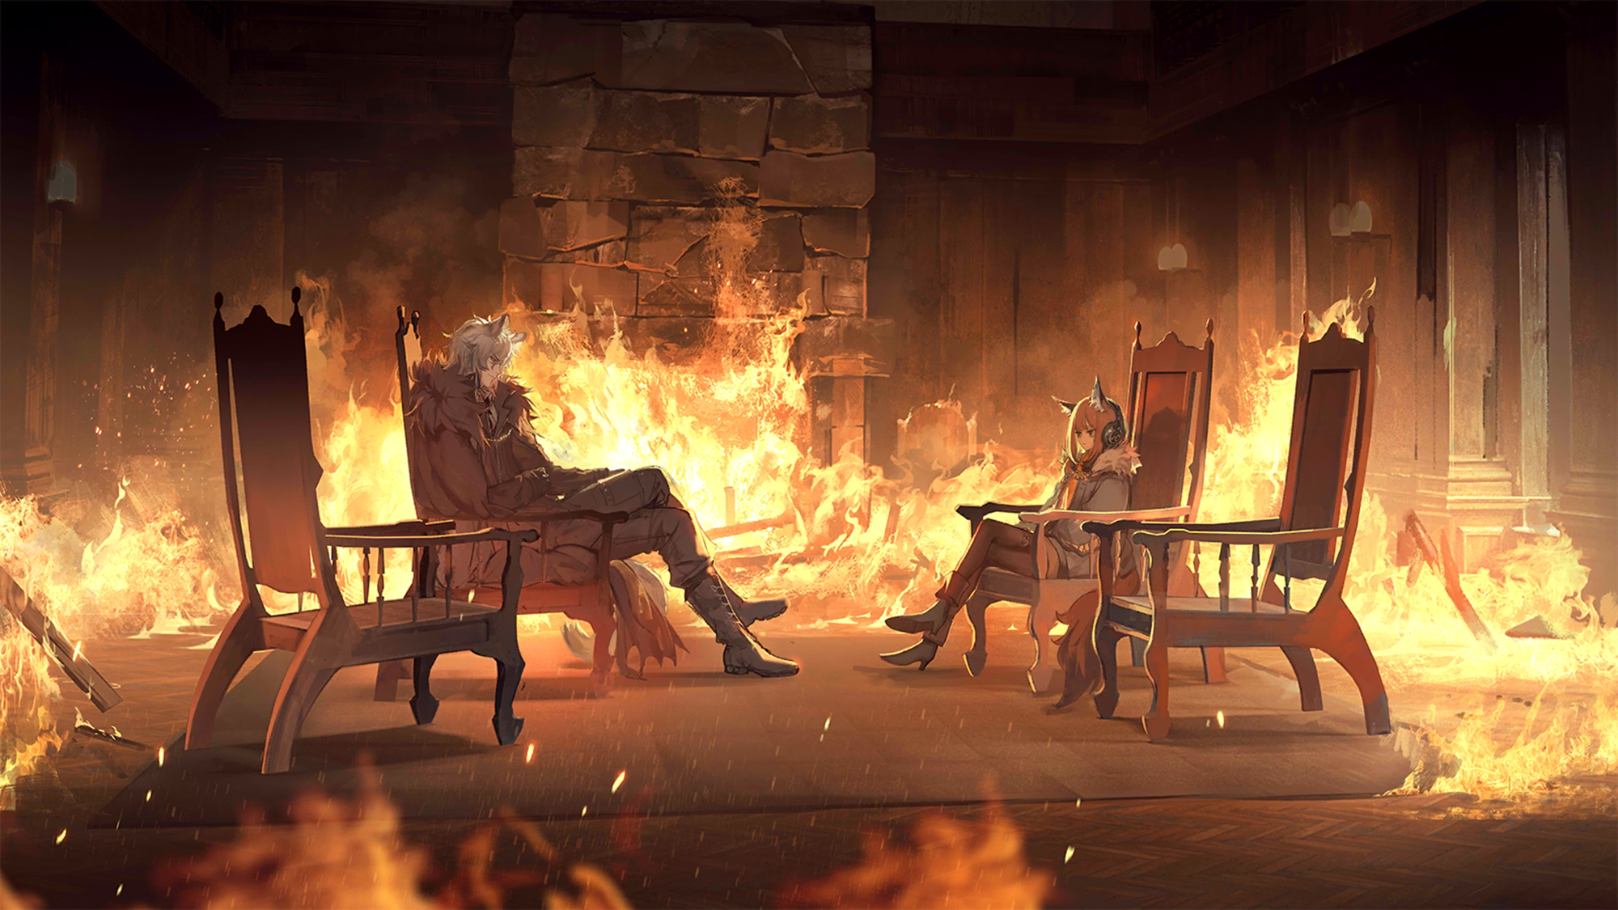
Kjerag Archives
Home
Explore
Advert
community
Arknights
Log in/sigh up
back
“chip“

Slide 18
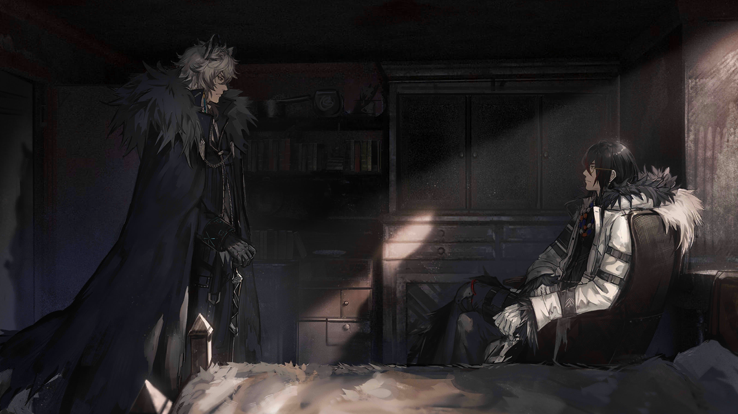
Kjerag Archives
Home
Explore
Advert
community
Arknights
Log in/sigh up
back
“banquet“

Slide 19
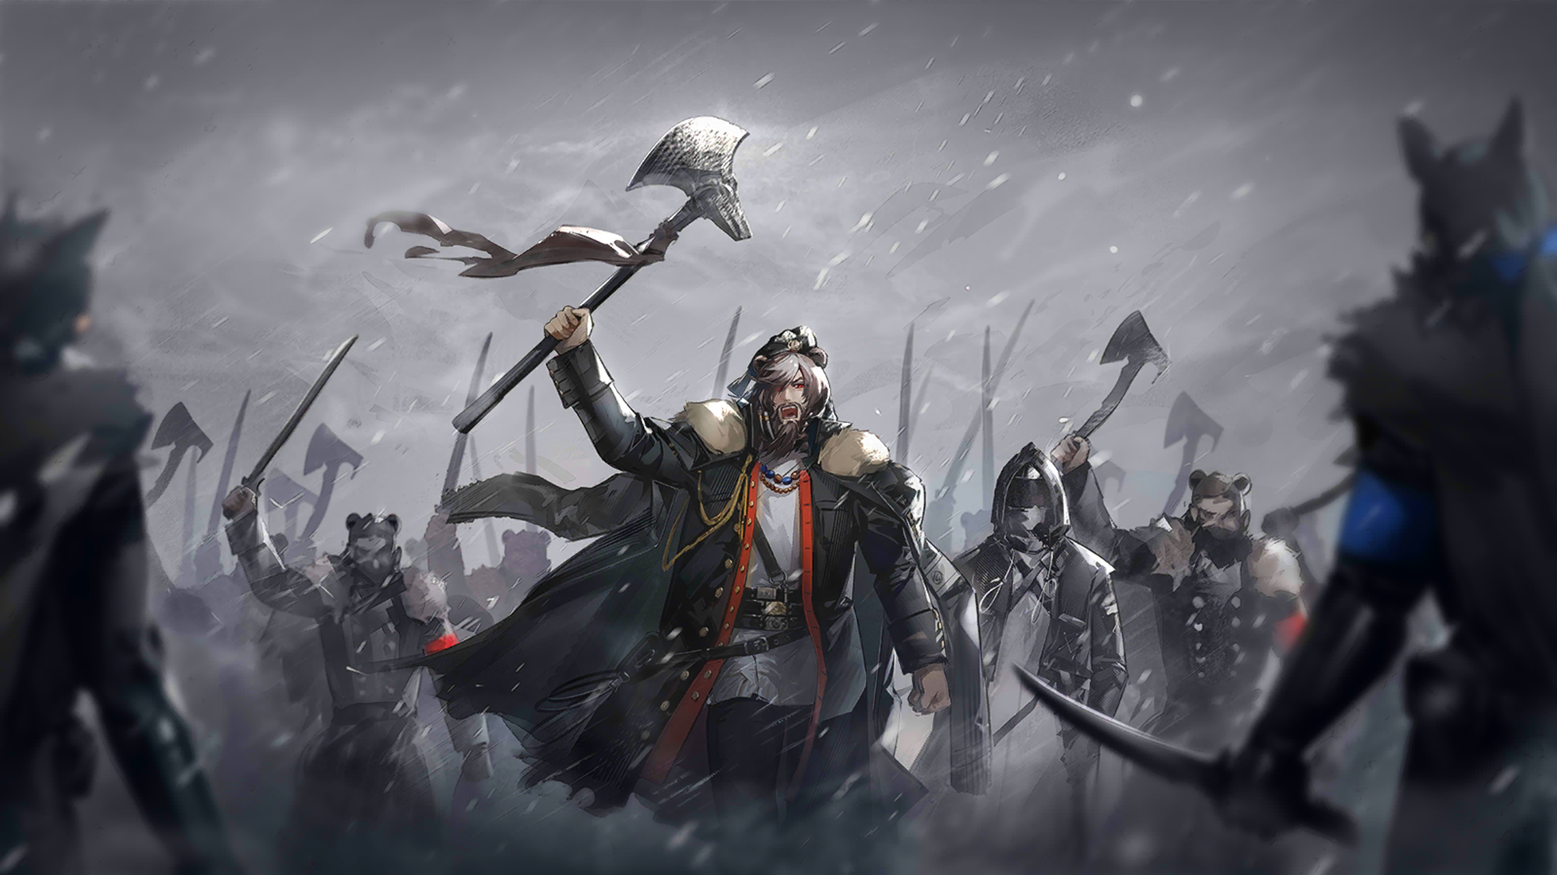
Kjerag Archives
Home
Explore
Advert
community
Arknights
Log in/sigh up
back
“unite“

Slide 20
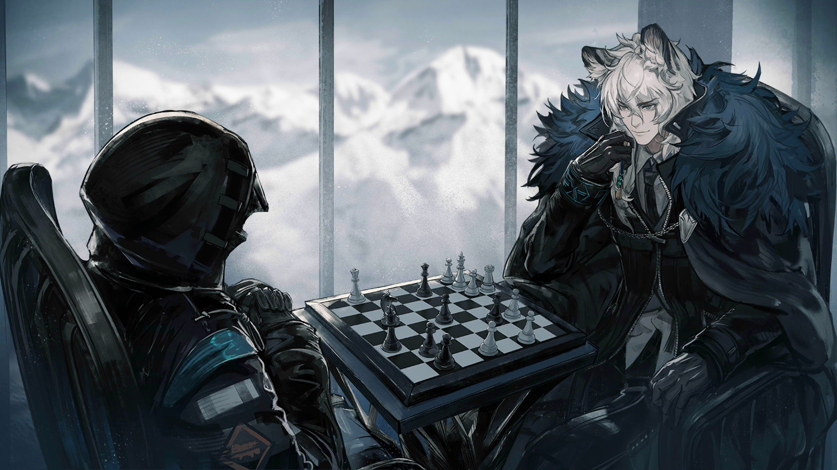
Kjerag Archives
Home
Explore
Advert
community
Arknights
Log in/sigh up
back
“have fun“

Slide 21
Kjerag Archives
Home
Explore
Advert
community
Arknights
Log in/sigh up
back
“chief“

Slide 22
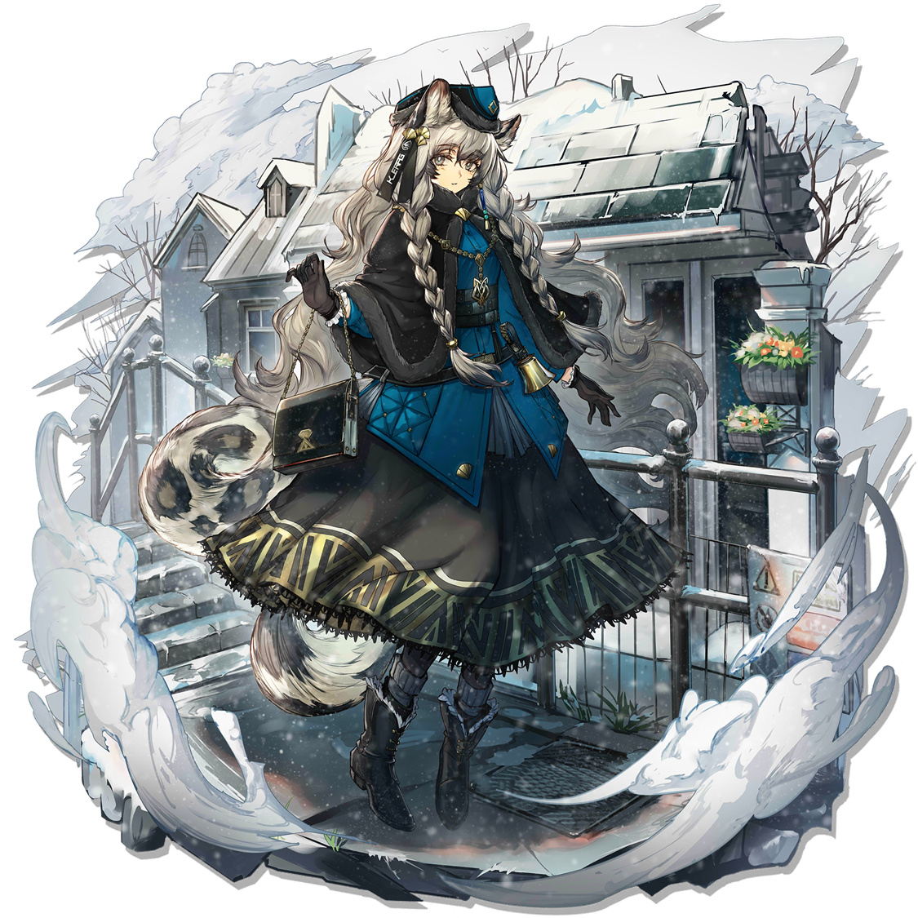

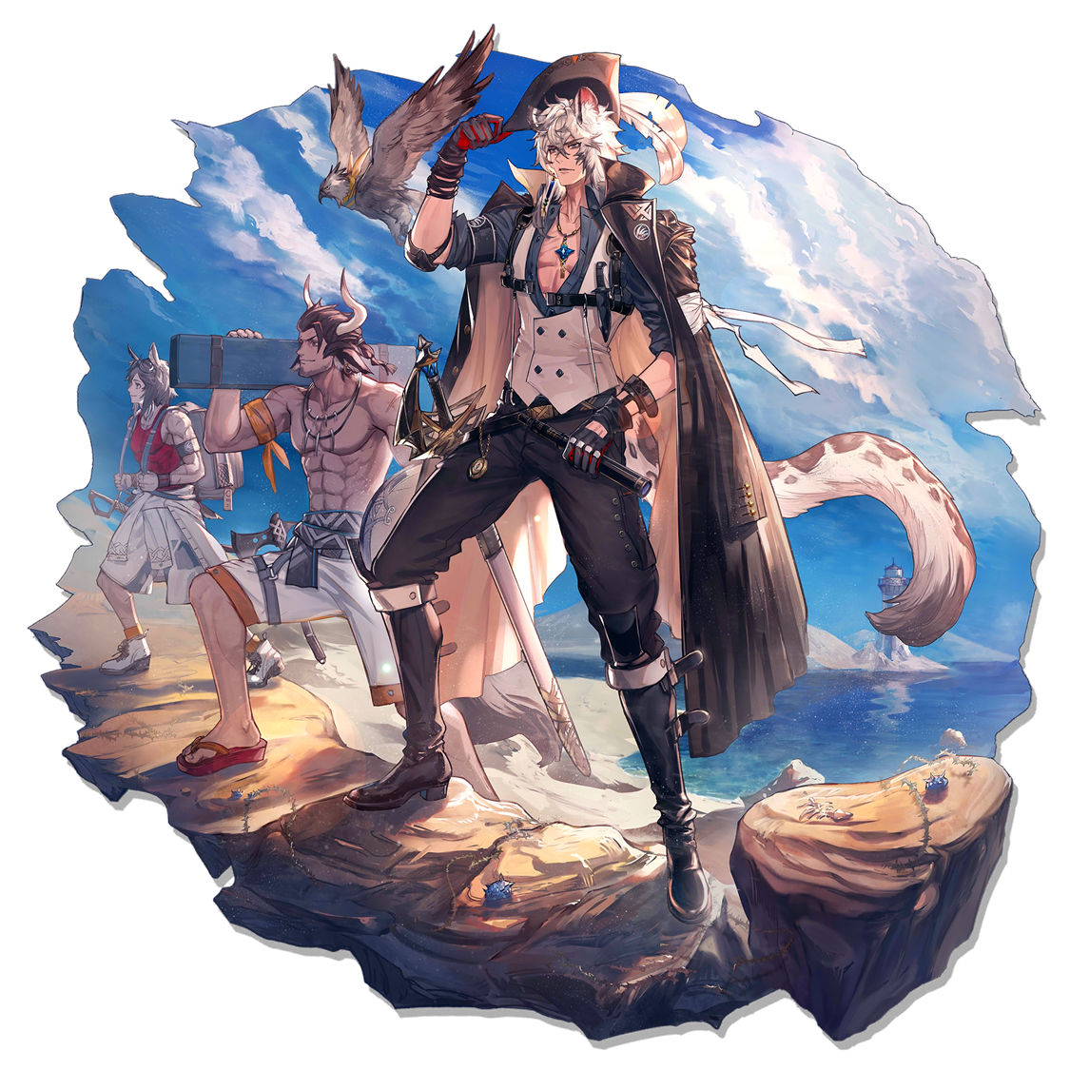
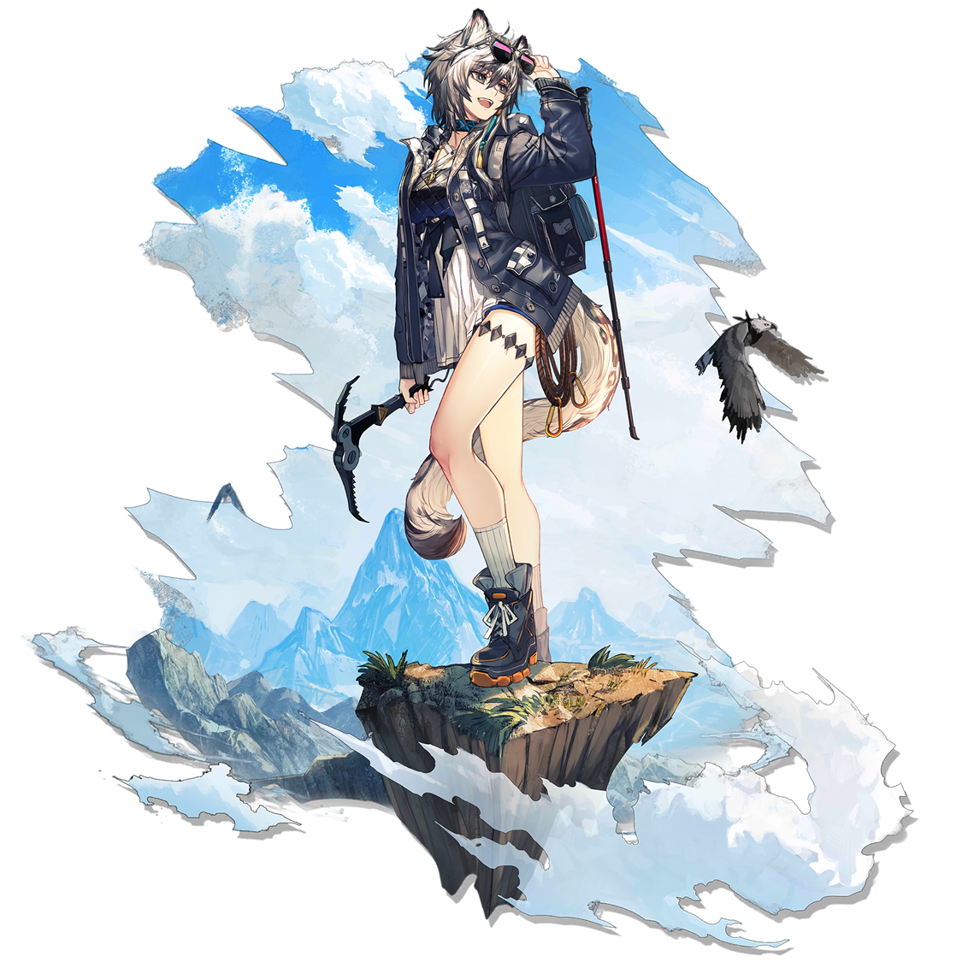
Kjerag Archives
Home
Explore
Advert
community
Arknights
Log in/sigh up
“them”
Kjerag,
a religious country
located in
the north central part of
the mainland.
It is not affected by natural disasters all the year round, with steep terrain and closed and conservative
Click for detail

Slide 23

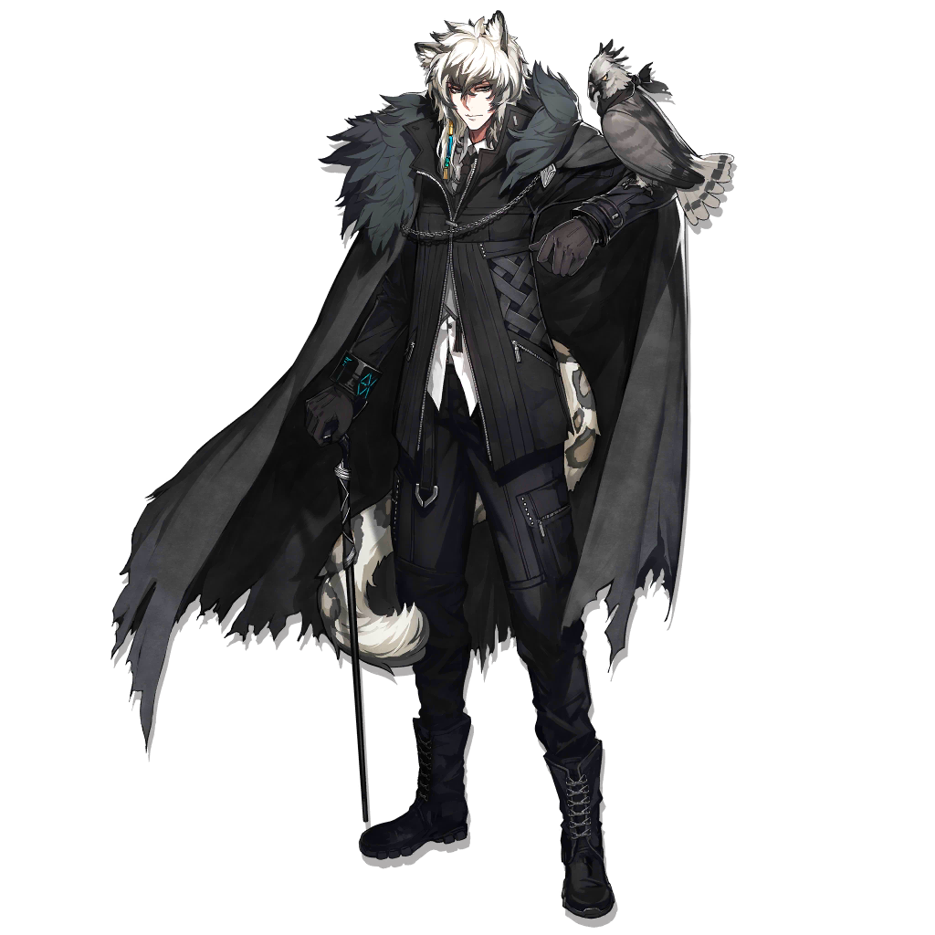
Kjerag Archives
Home
Explore
Advert
community
Arknights
Log in/sigh up
“them”
SilverAsh(left 1) Sherag Warlord, He has unique views on economy and trade, international politics, diplomatic tactics and tactical planning.
SilverAsh

Slide 24
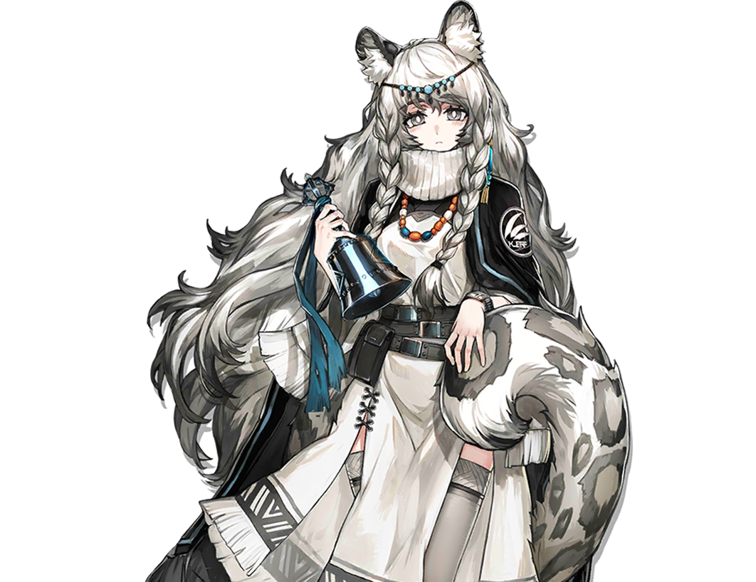
Kjerag Archives
Home
Explore
Advert
community
Arknights
Log in/sigh up
“them”
Pramanix，
Holy Daughter, the religious leader of
Sherag. Use the holy bell given by God to call for the power of wind and snow.
Pramanix

Slide 25
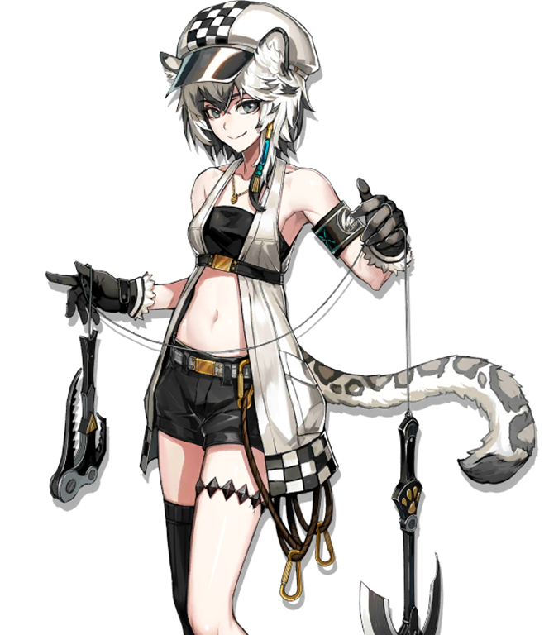
Kjerag Archives
Home
Explore
Advert
community
Arknights
Log in/sigh up
“them”
Cliffheart，
Experts in rock climbing and mountaineering can skillfully use various climbing tools..
CLIFFheart

Slide 26
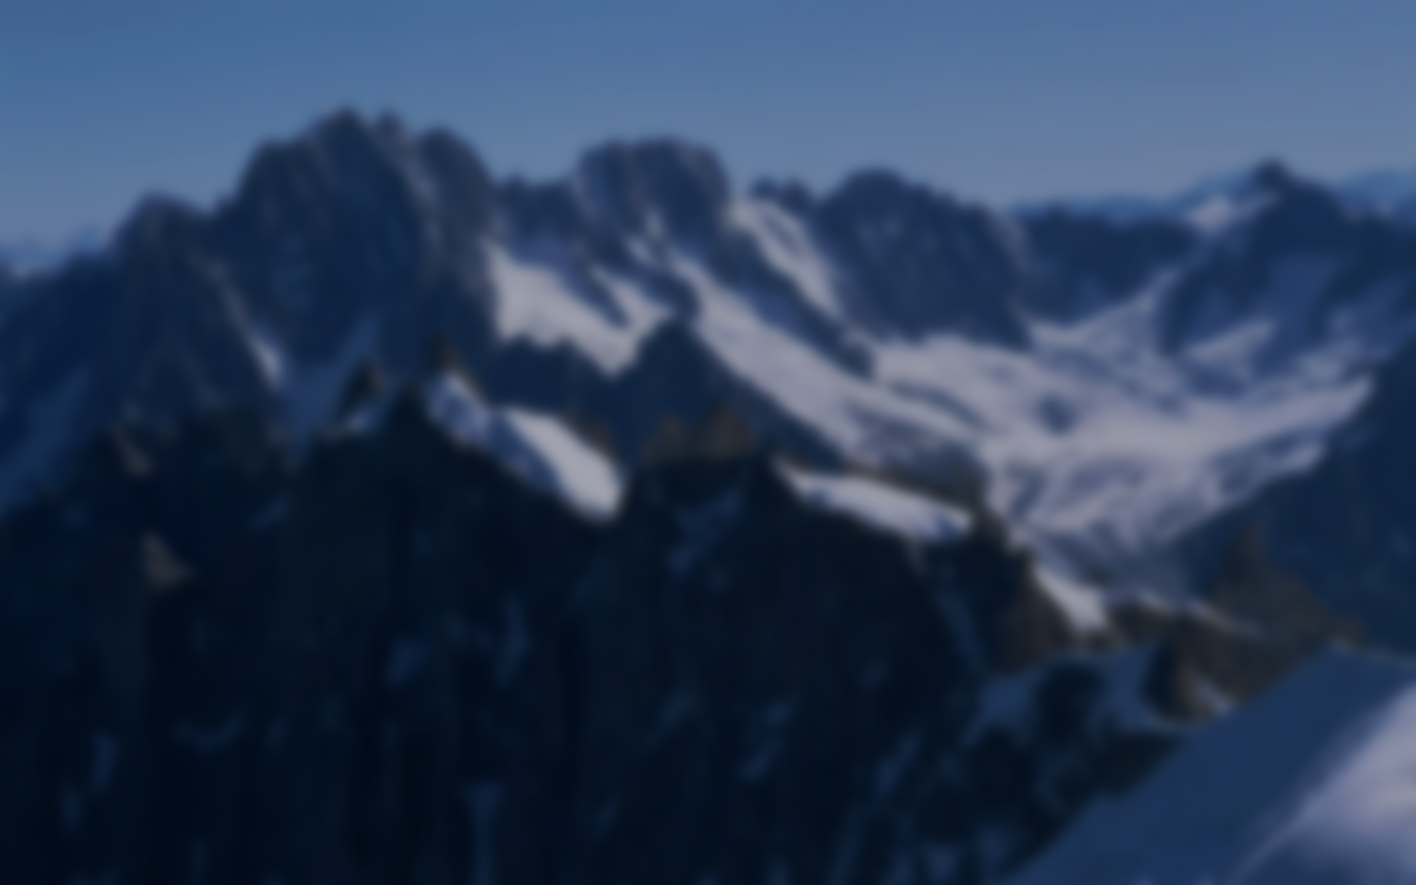
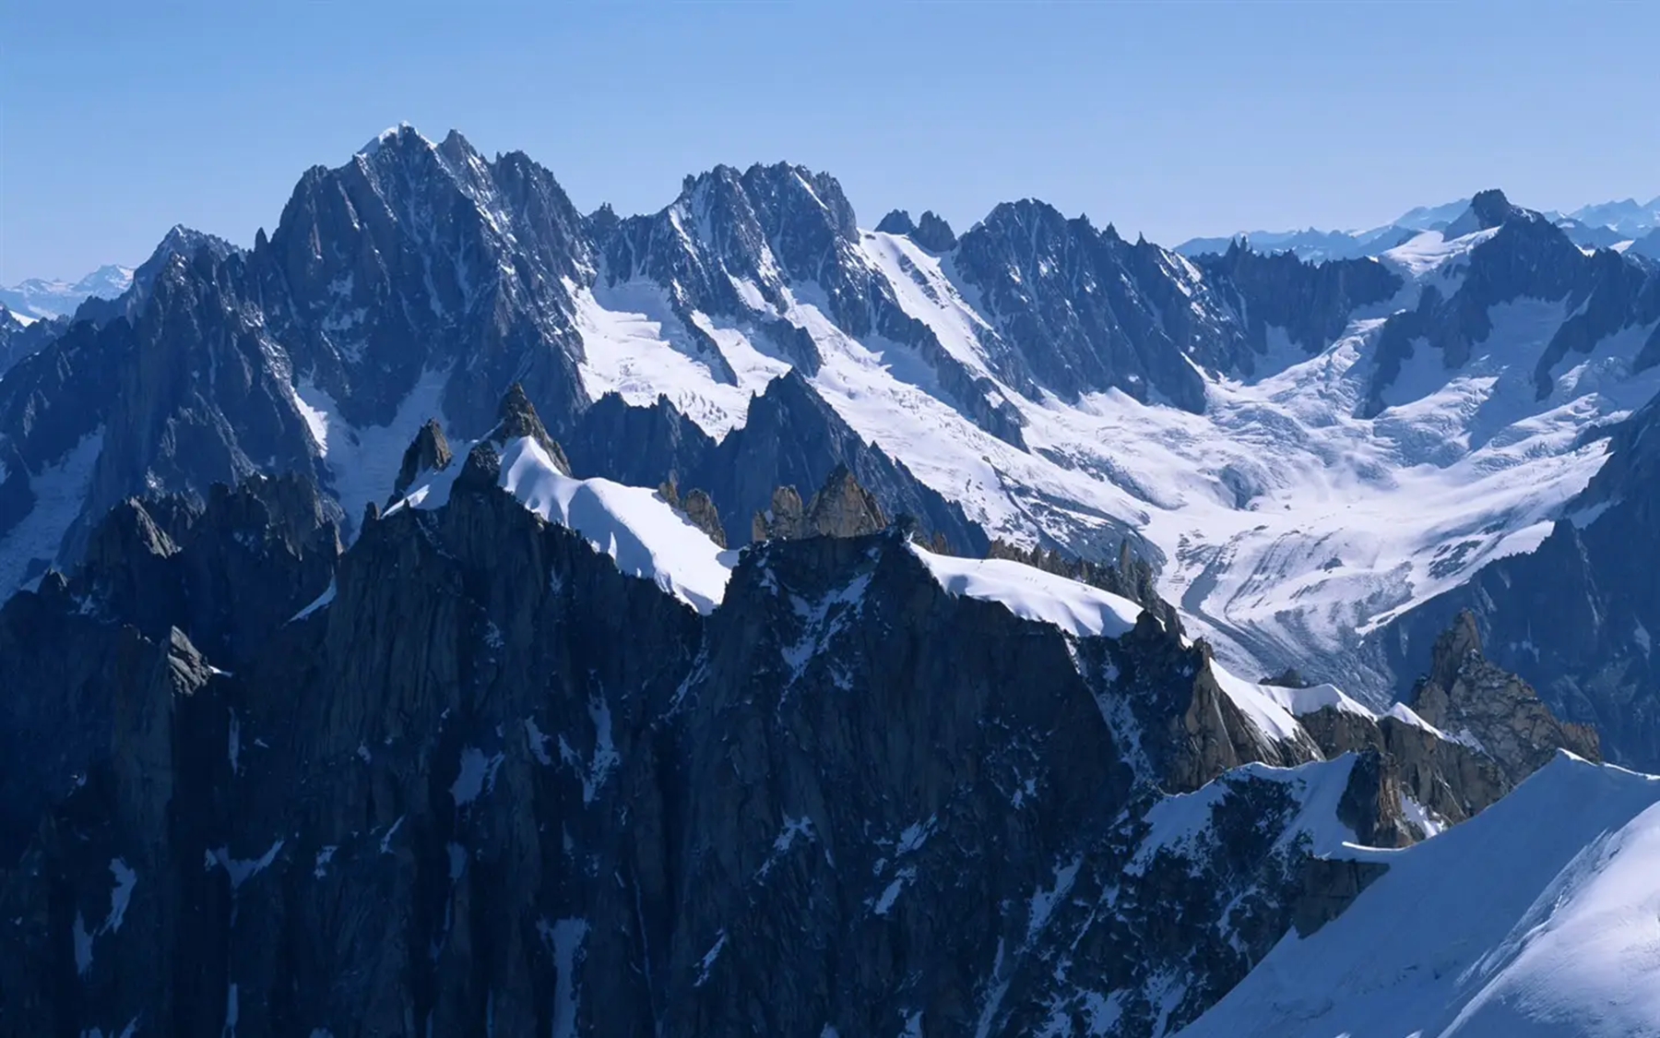

PIONEER
EXPLORING
THE UNKNOWN

Slide 27
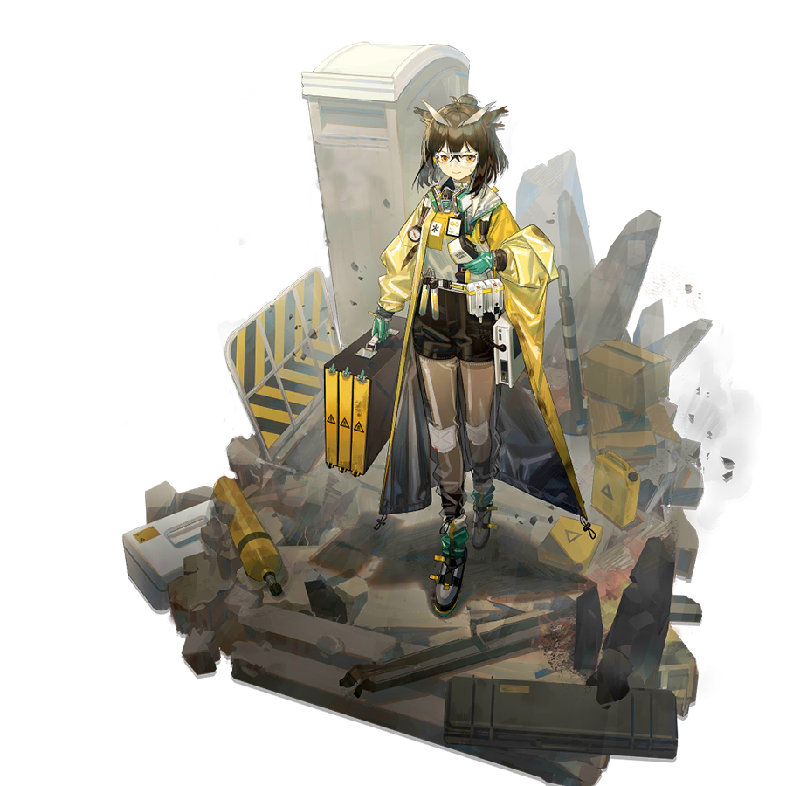


RAYTHEAN PIONEER
PIONEER
EXPLORING
THE UNKNOWN

Slide 28
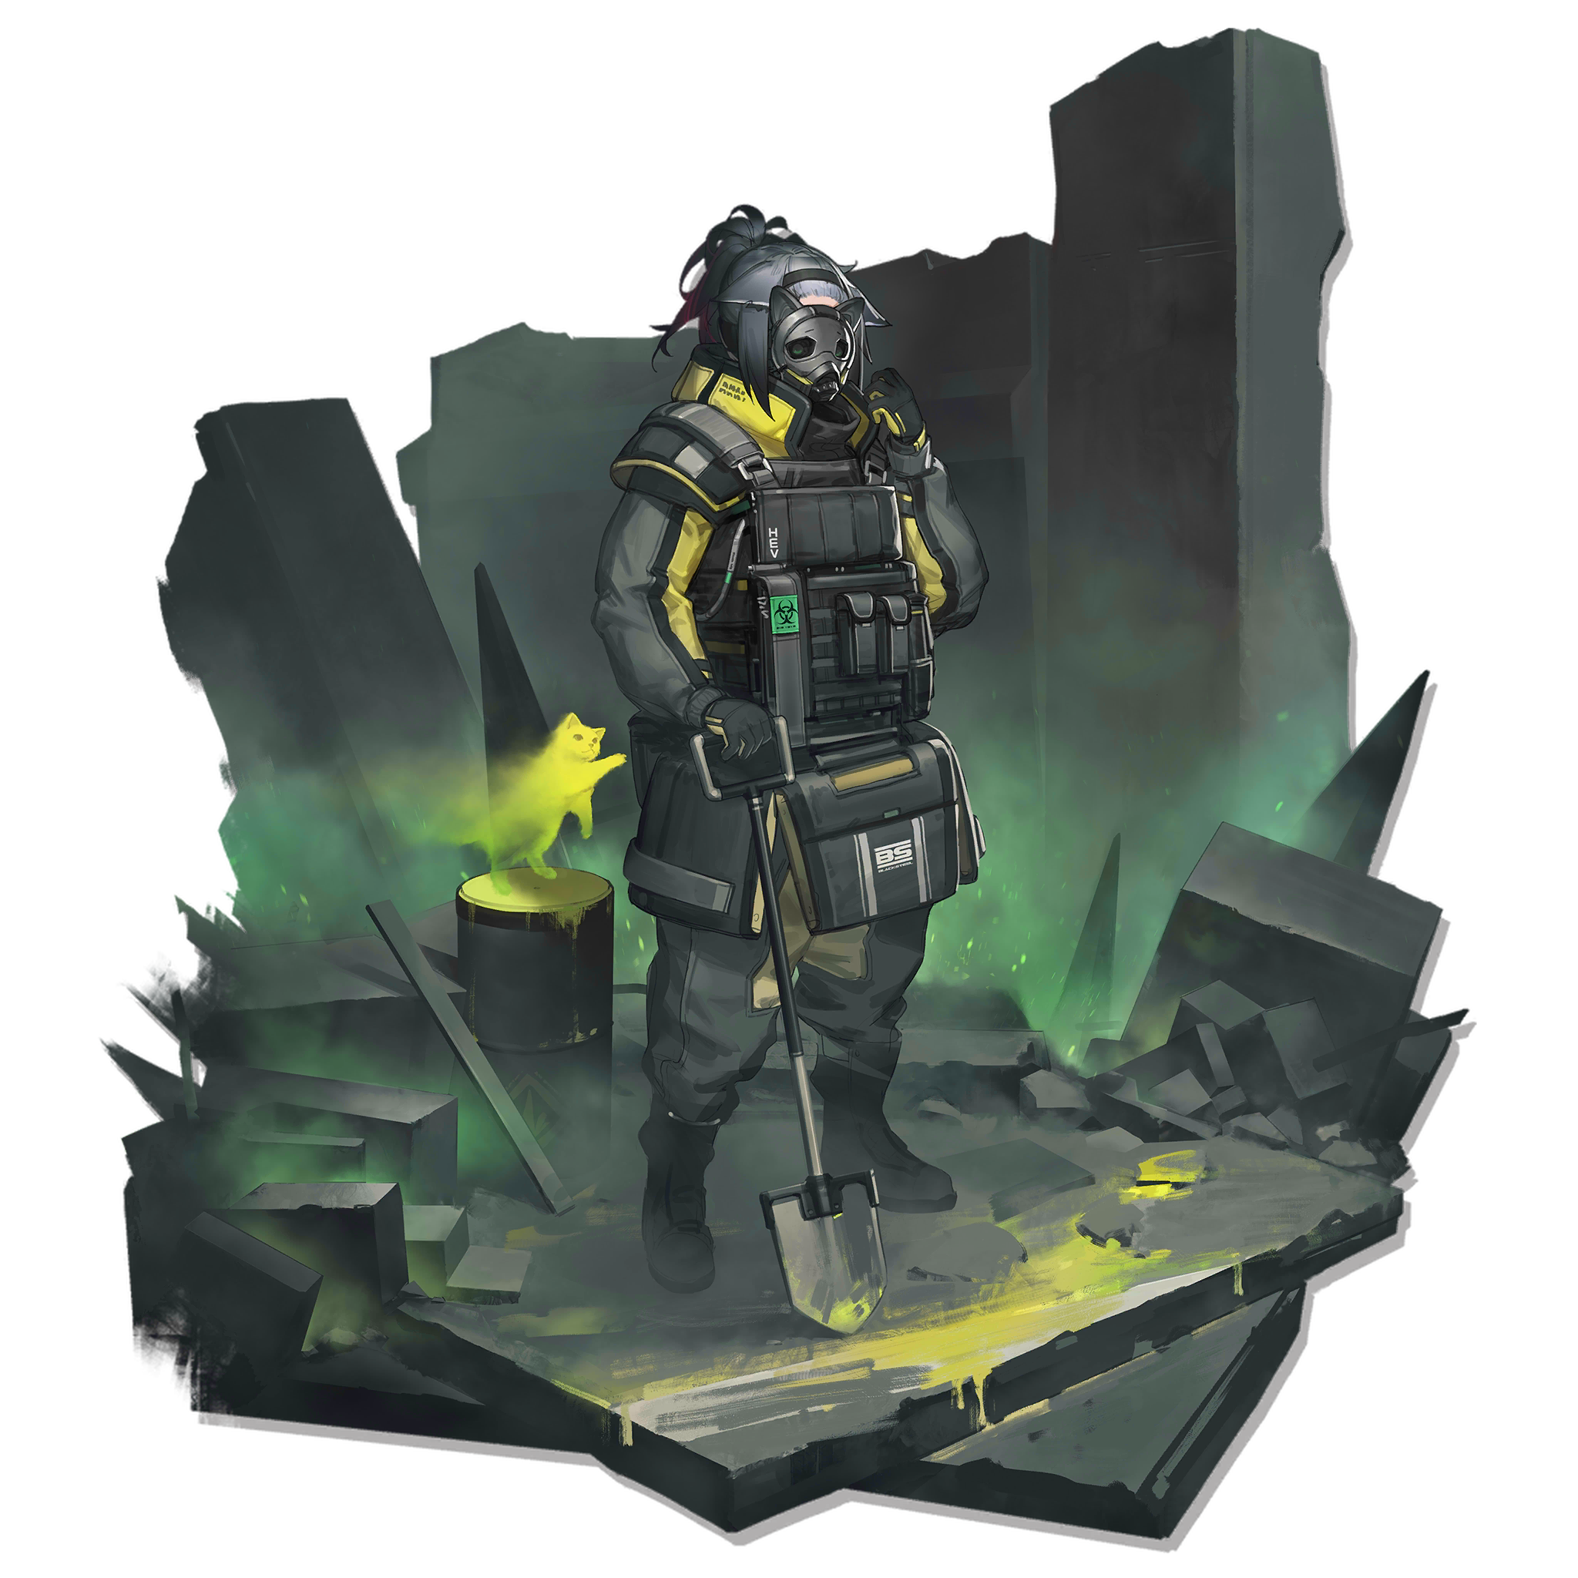
PIONEER EXPLORING
THE UNKNOWN
RAYTHEAN
PIONEER

Slide 29
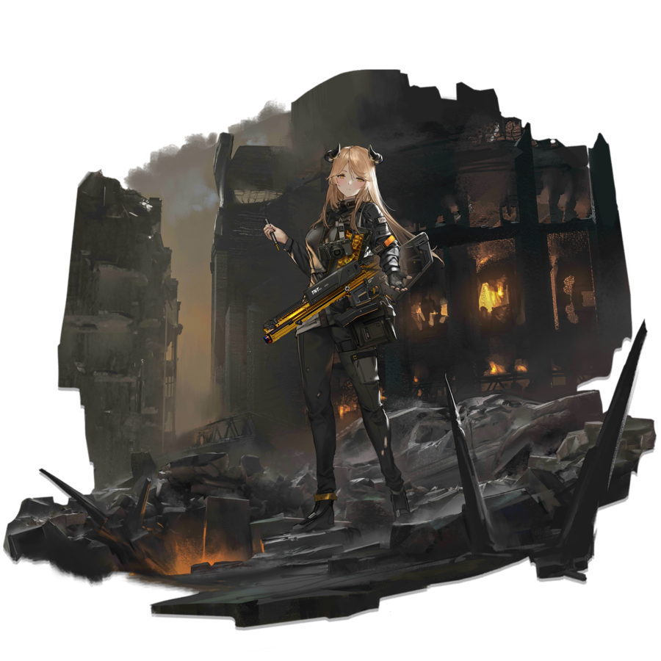
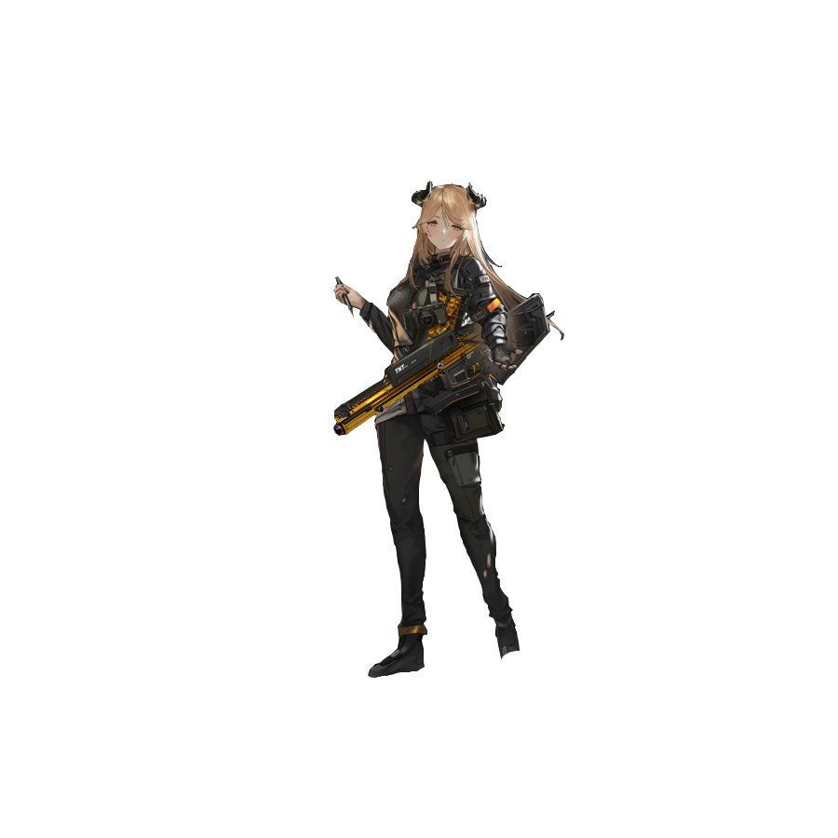
RAYTHEAN PIONEER
PIONEER
EXPLORING
THE UNKNOWN

Slide 30


Slide 31
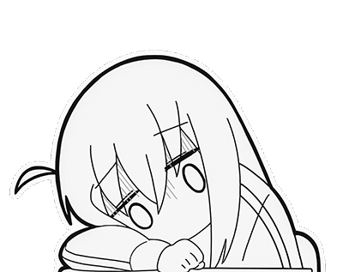
我可能做不好实用风格
但是别的网站上实用风格已经够多了！
如果你想要呈现高端大气的风格，
只要把字改的小到别人瞪大眼也看不清，然后把所有矩形换成圆角的就好，矩形看起来硬一点
但是学生作业最基础的就是看得清就好
我也不专业，还是去做孤独摇滚PPT吧
喜欢可以点点三连谢谢喵
有问题可以来恰个Q群
419272459

Slide 32

账号
bilibili@养猪学家
密码
●●●●●
●●●●●●●●●●

Slide 33


Slide 34
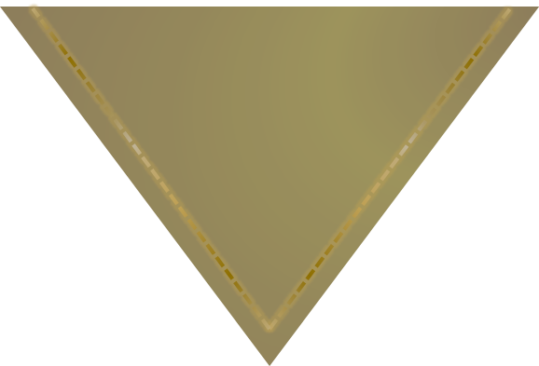

Slide 36














Slide 37


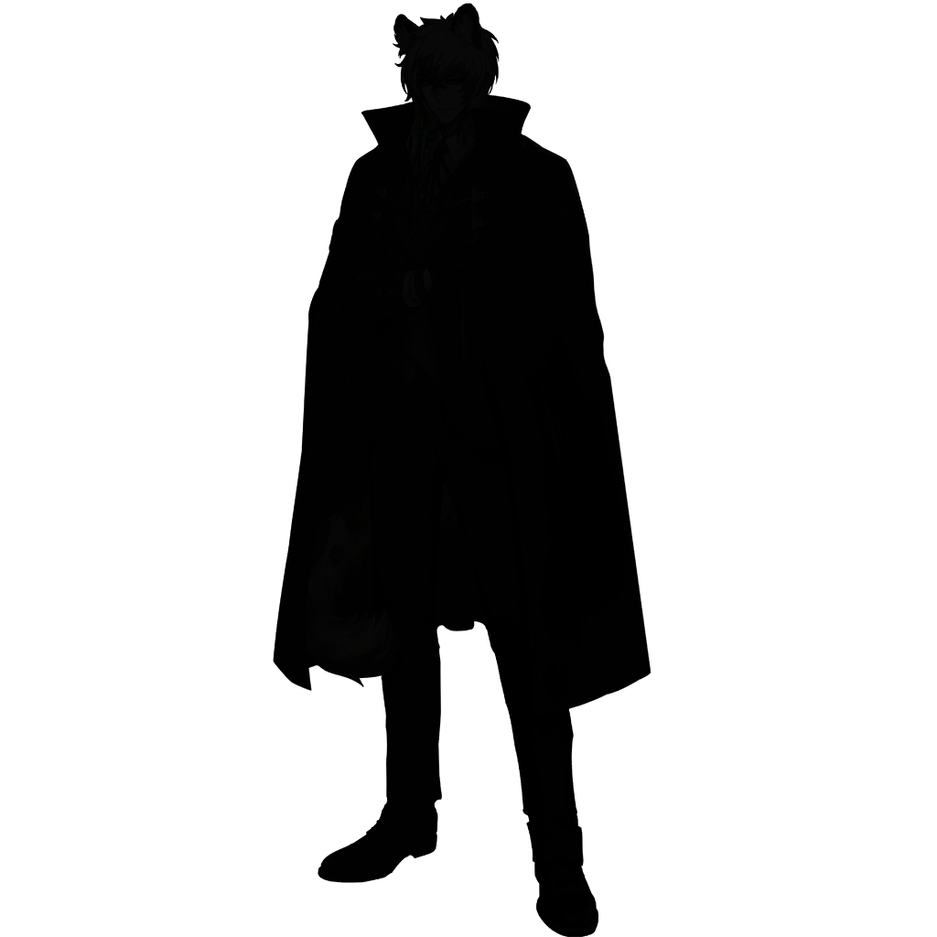


Slide 39
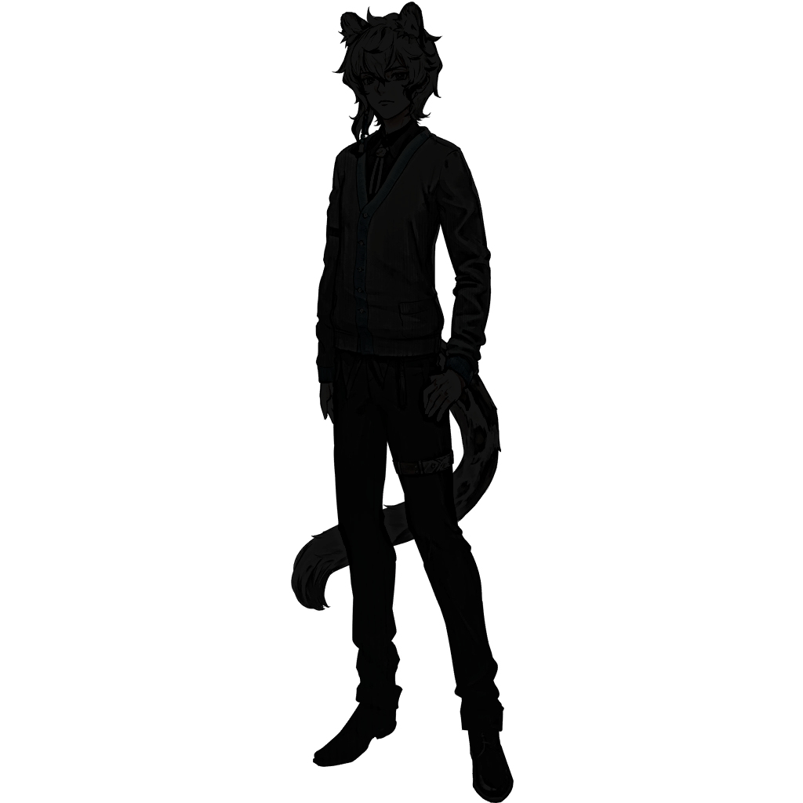
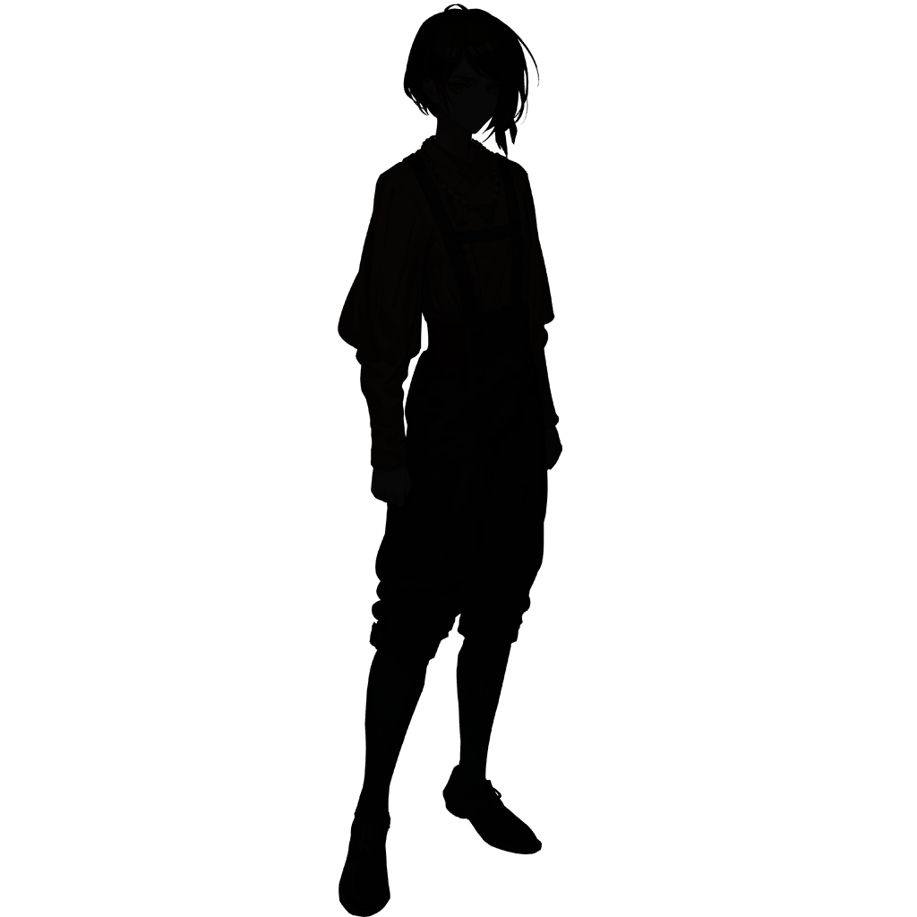

Slide 40
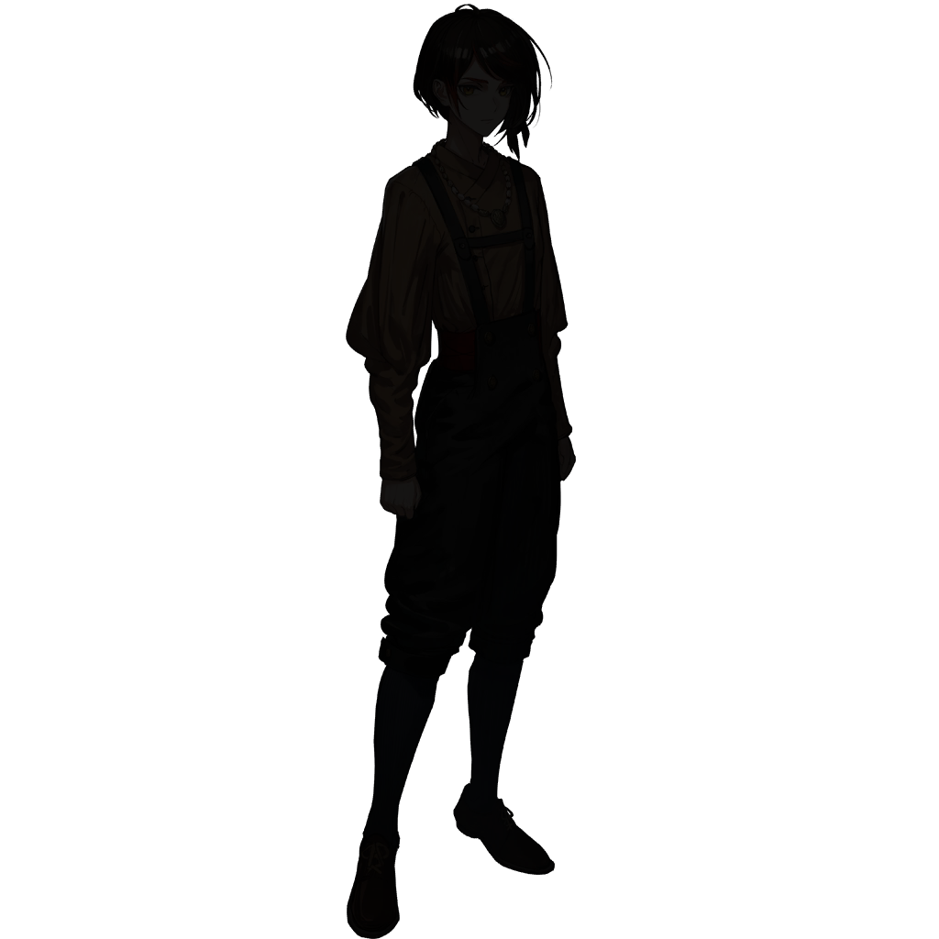
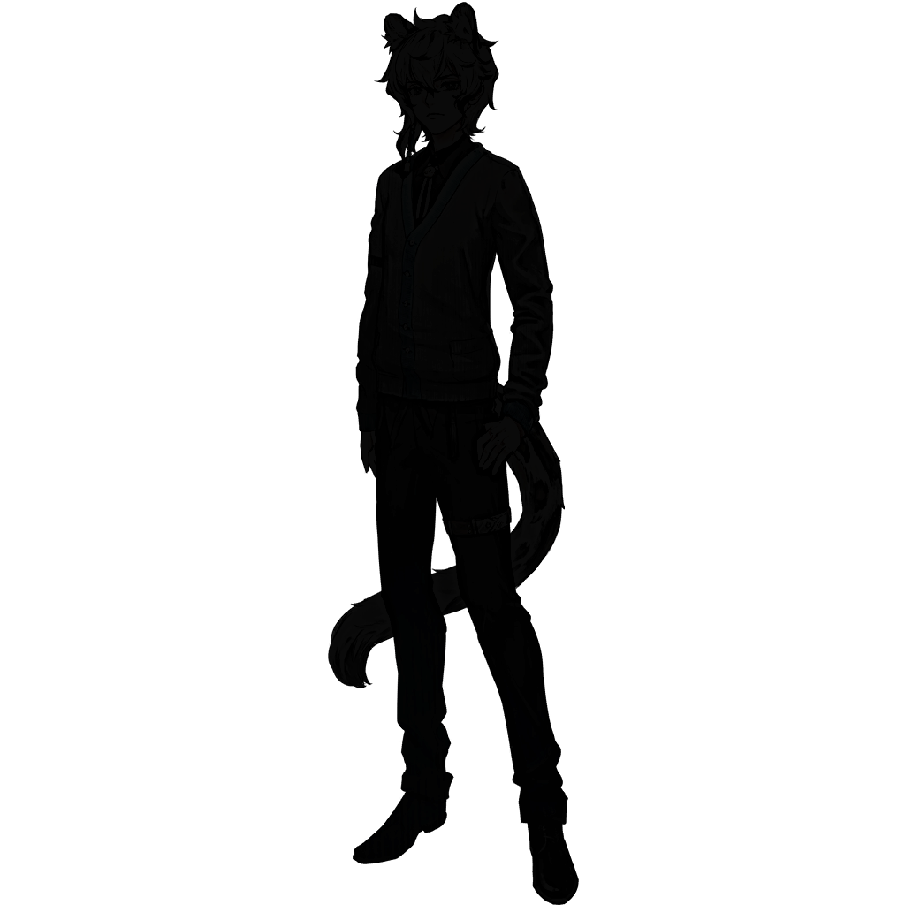

Slide 41


Slide 42



Slide 43
